Slide 1
8
Aquatic Biodiversity

Slide 2
Core Case Study: Why Should We Care about Coral Reefs?
Biodiversity
Coral reefs form in clear, warm coastal waters in tropical areas
Tiny animals (polyps) and algae have a mutualistic relationship
Polyps secrete calcium carbonate shells, which become coral reefs

Slide 3
Core Case Study: Why Should We Care about Coral Reefs? (cont’d.)
Provide important ecological and economic services
Vulnerable to damage
Warmer ocean temperatures leading to coral bleaching
Kills algae and thus the polyps
Increasing ocean acidity

Slide 4
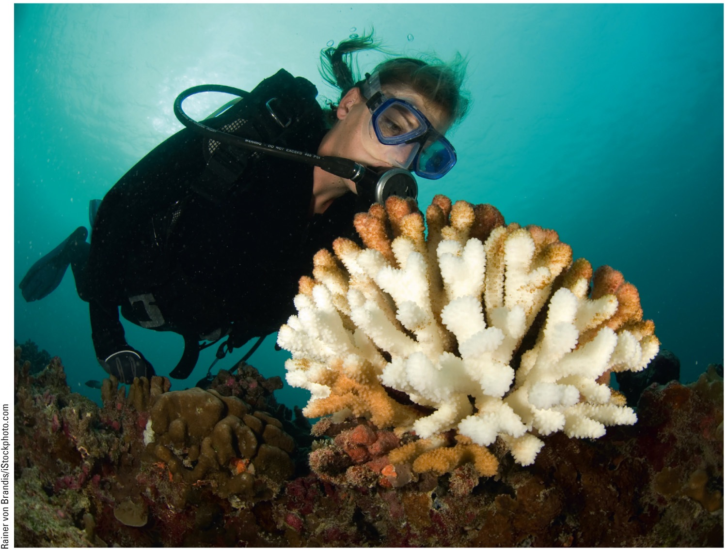
Core Case Study: Why Should We Care about Coral Reefs? (cont’d.)
Fig. 8-1, p. 168
Notes:
Figure 8-1: This bleached coral has lost most of its algae because of changes in the environment such as warming of the waters and deposition of sediments.

Slide 5
8-1 What Is the General Nature of Aquatic Systems?
Saltwater and freshwater aquatic life zones cover almost three-fourths of the earth’s surface, with oceans dominating the planet
Key factors determining biodiversity in aquatic systems
Temperature, dissolved oxygen content, availability of food, and access to light and nutrients necessary for photosynthesis

Slide 6
Most of the Earth Is Covered with Water
Saltwater – 71% of the earth’s surface
Global ocean divided into four areas
Atlantic
Pacific
Arctic
Indian
Freshwater – 2.2% of the earth’s surface

Slide 7
Most of the Earth Is Covered with Water (cont’d.)
Aquatic life zones
Saltwater life zones (marine life zones)
Oceans and estuaries
Coastlands and shorelines
Coral reefs
Mangrove forests
Freshwater life zones
Lakes, rivers, and streams
Inland wetlands

Slide 8
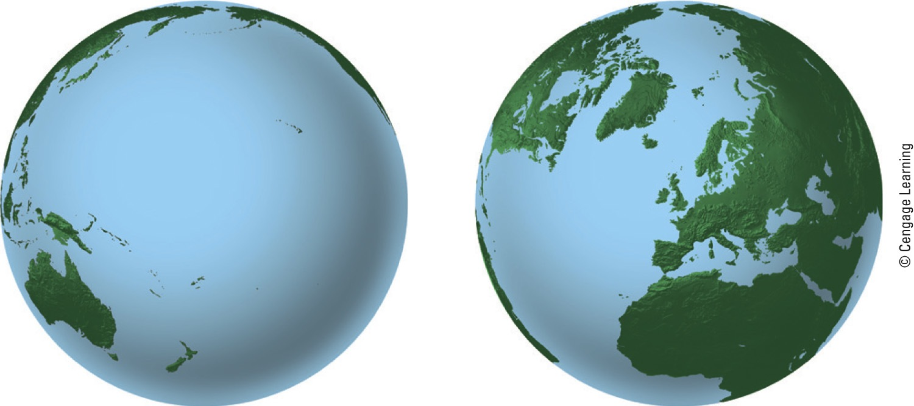
Ocean hemisphere
Land–ocean hemisphere
Fig. 8-2, p. 169
Notes:
Figure 8-2: The ocean planet: The salty oceans cover 90% of the planet’s ocean hemisphere (left) and nearly half of its land–ocean hemisphere (right) (Concept 8-1A).

Slide 9
Aquatic Species Drift, Swim, Crawl, and Cling
Plankton – drifting
Phytoplankton
Primary producers for most aquatic food webs
Ultraplankton
Tiny photosynthetic bacteria
Zooplankton
Secondary consumers
Single-celled to large invertebrates like jellyfish

Slide 10
Aquatic Species Drift, Swim, Crawl, and Cling (cont’d.)
Nekton
Strong swimmers – fish, turtles, whales
Benthos
Bottom dwellers – oysters, sea stars, clams, lobsters, crabs
Decomposers
Mostly bacteria

Slide 11
Aquatic Species Drift, Swim, Crawl, and Cling (cont’d.)
Key factors in the distribution of organisms
Temperature
Dissolved oxygen content
Availability of food
Availability of light and nutrients needed for photosynthesis
Turbidity
Degree of cloudiness in water
Inhibits photosynthesis

Slide 12
8-2 Why Are Marine Aquatic Systems Important?
Saltwater ecosystems
Provide major ecosystem and economic services
Are irreplaceable reservoirs of biodiversity

Slide 13
Oceans Provide Vital Ecosystem and Economic Services
Estimated $12 trillion per year in goods and services
Three major life zones:
Coastal zone
Warm, nutrient rich, shallow; shore to edge of continental shelf; usually high NPP from ample sunlight and nutrients
Open sea
Ocean bottom

Slide 14
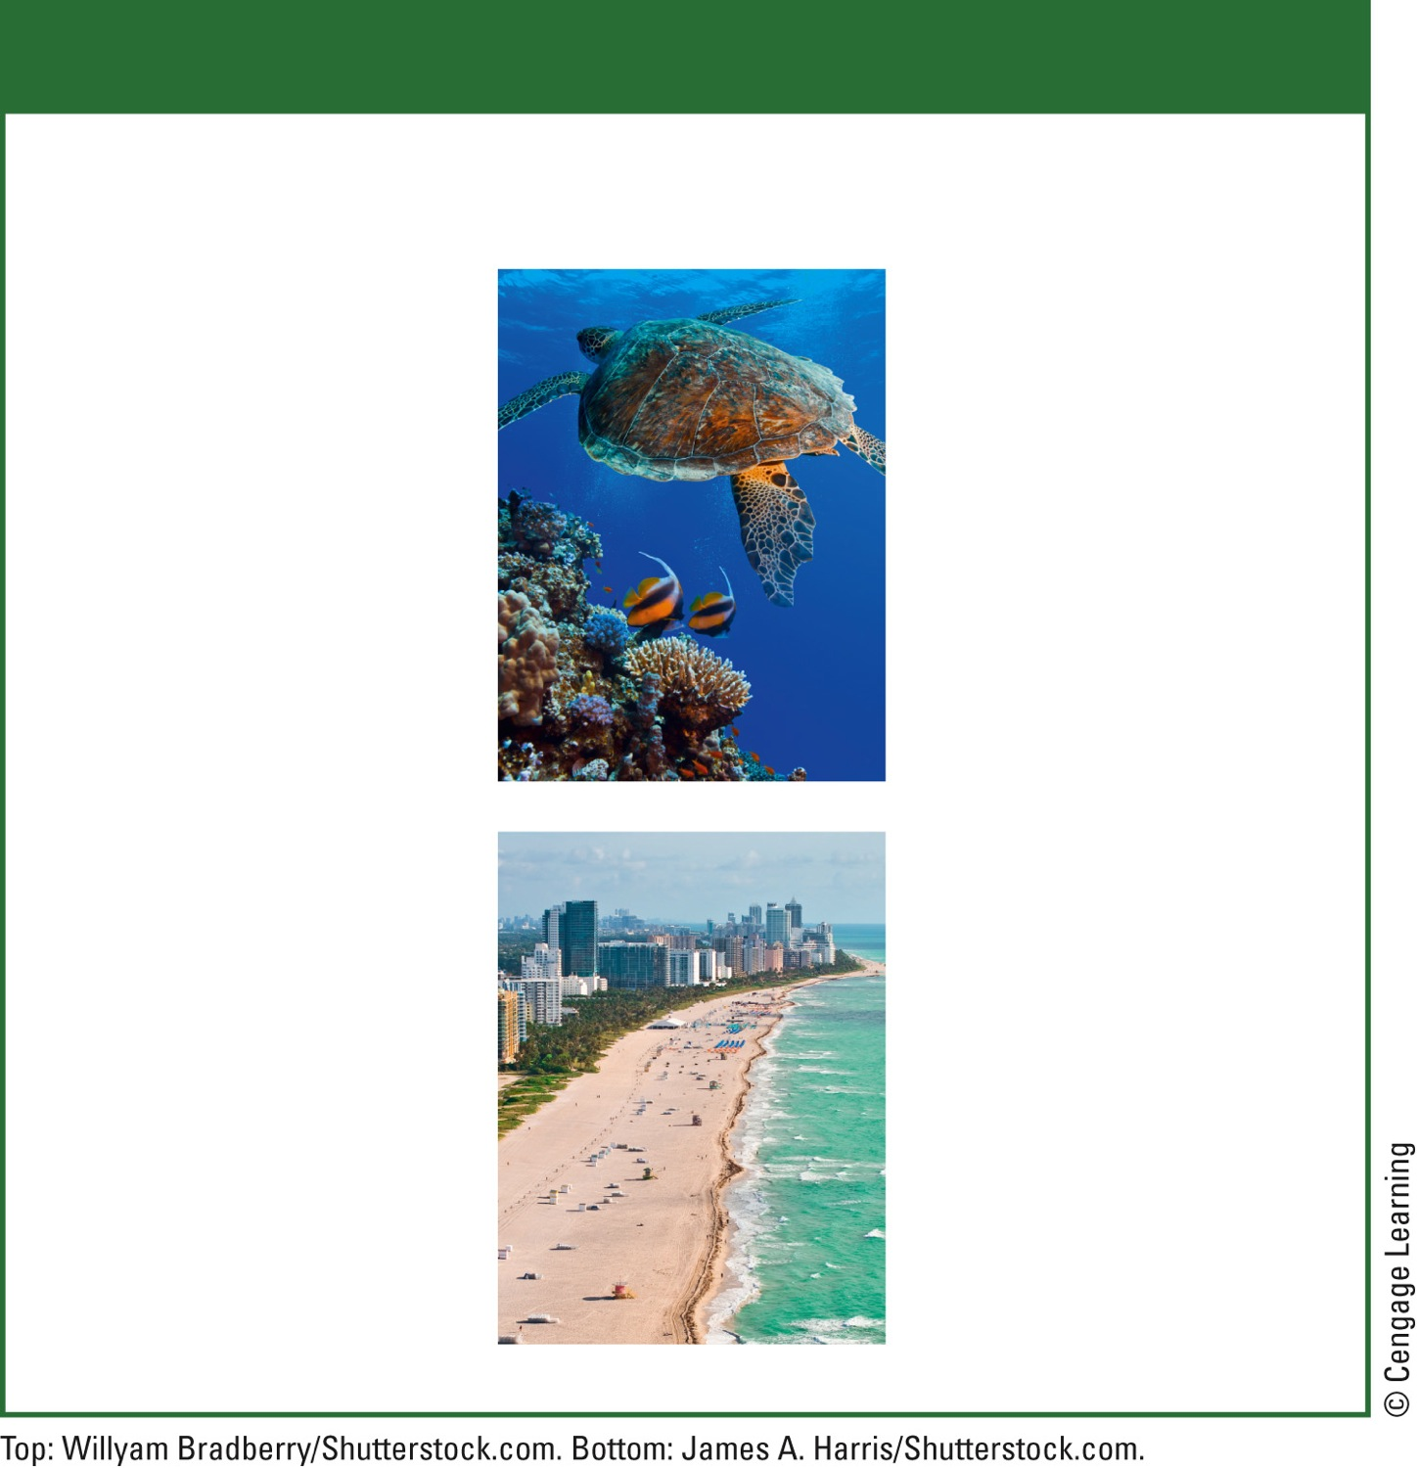
Natural Capital
Marine Ecosystems
Ecological Services
Economic Services
Oxygen supplied through photosynthesis
Food
Energy from waves and tides
Water purification
Climate moderation
Pharmaceuticals
CO₂ absorption
Harbors and transportation routes
Nutrient cycling
Reduced storm impact (mangroves, barrier islands, coastal wetlands)
Recreation and tourism
Employment
Biodiversity:
species and habitats
Minerals
Fig. 8-5, p. 170
Notes:
Figure 8.5: Marine systems provide a number of important ecological and economic services (Concept 8-2). Questions: Which two ecological services and which two economic services do you think are the most important? Why?

Slide 15
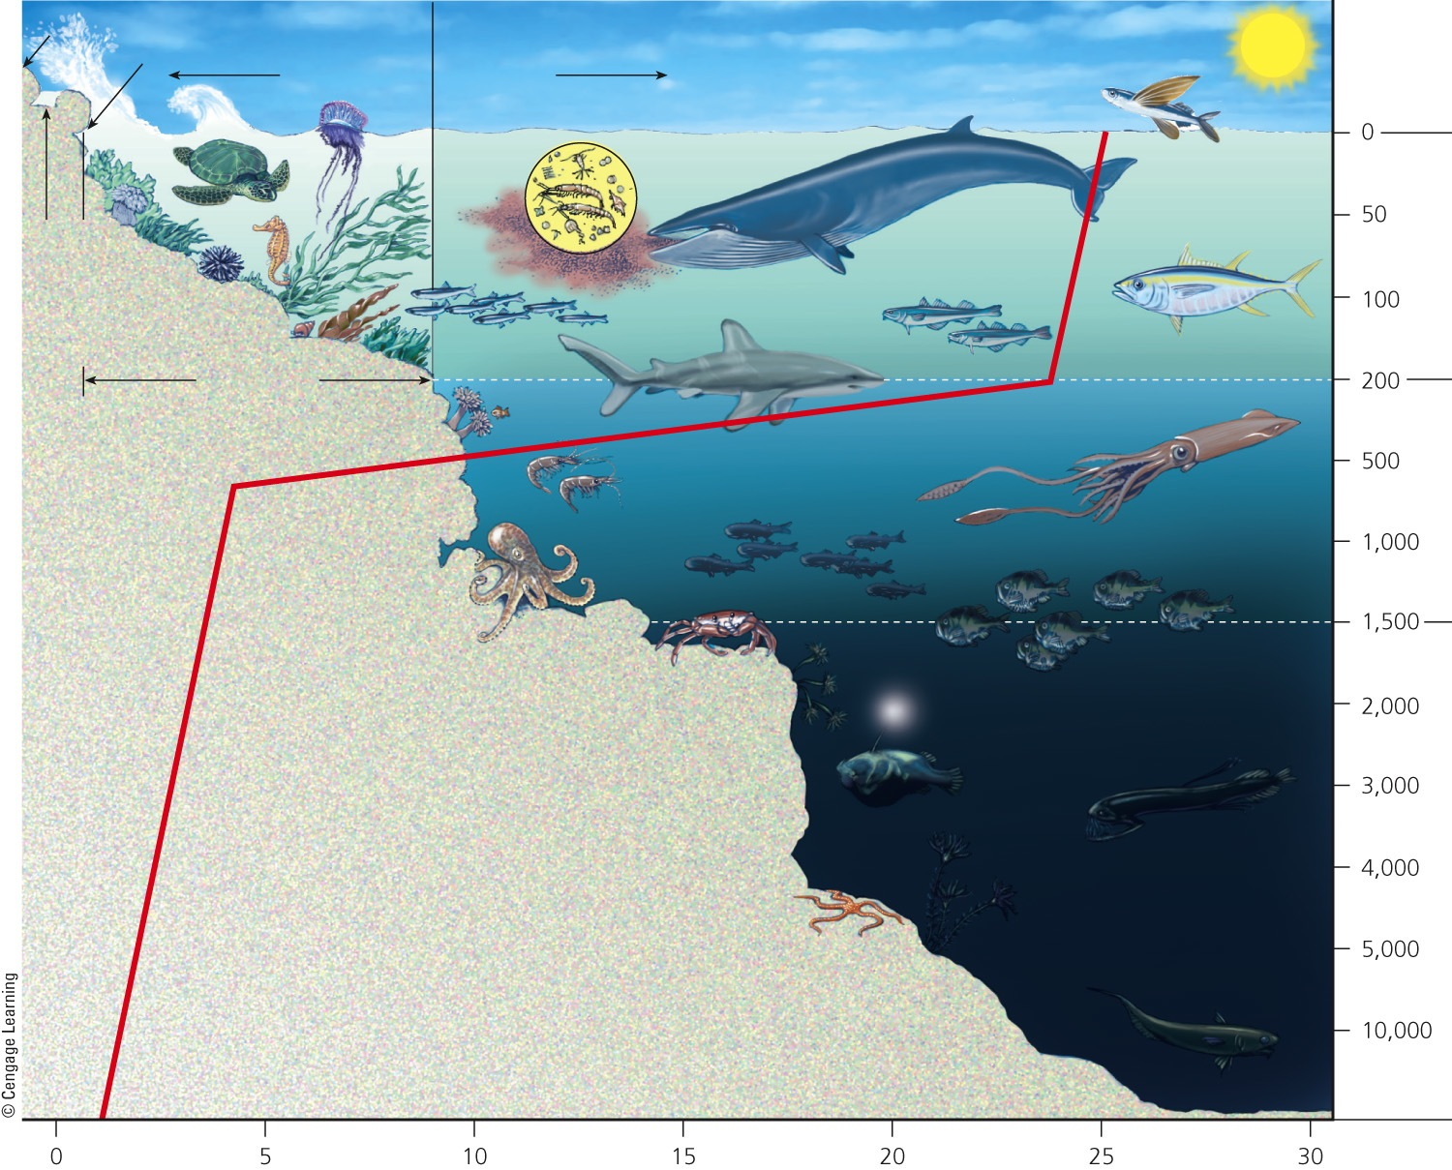
High tide
Coastal Zone
Open Sea
Low tide
Depth in meters
Sea level
Euphotic Zone
Photosynthesis
Estuarine Zone
Continental shelf
Bathyal Zone
Twilight
Water temperature drops rapidly between the euphotic zone and the abyssal zone in an area called the thermocline.
Abyssal Zone
Darkness
Water temperature (°C)
Fig. 8-6, p. 171
Notes:
Figure 8.6: This diagram illustrates the major life zones and vertical zones (not drawn to scale) in an ocean. Actual depths of zones may vary. Available light determines the euphotic, bathyal, and abyssal zones. Temperature zones also vary with depth, shown here by the red line. Question: How is an ocean like a rain forest? (Hint: see Figure 7-14, p. 157.)

Slide 16
Estuaries and Coastal Wetlands Are Highly Productive
Estuaries
Where rivers meet the sea
Coastal wetlands
Coastal land covered with water all or part of the year
Seawater mixes with freshwater
Very productive ecosystems with high nutrient levels

Slide 17
Estuaries and Coastal Wetlands Are Highly Productive (cont’d.)
Examples:
River mouths
Inlets
Bays
Sounds
Salt marshes
Sea-grass beds
Mangrove forests

Slide 18
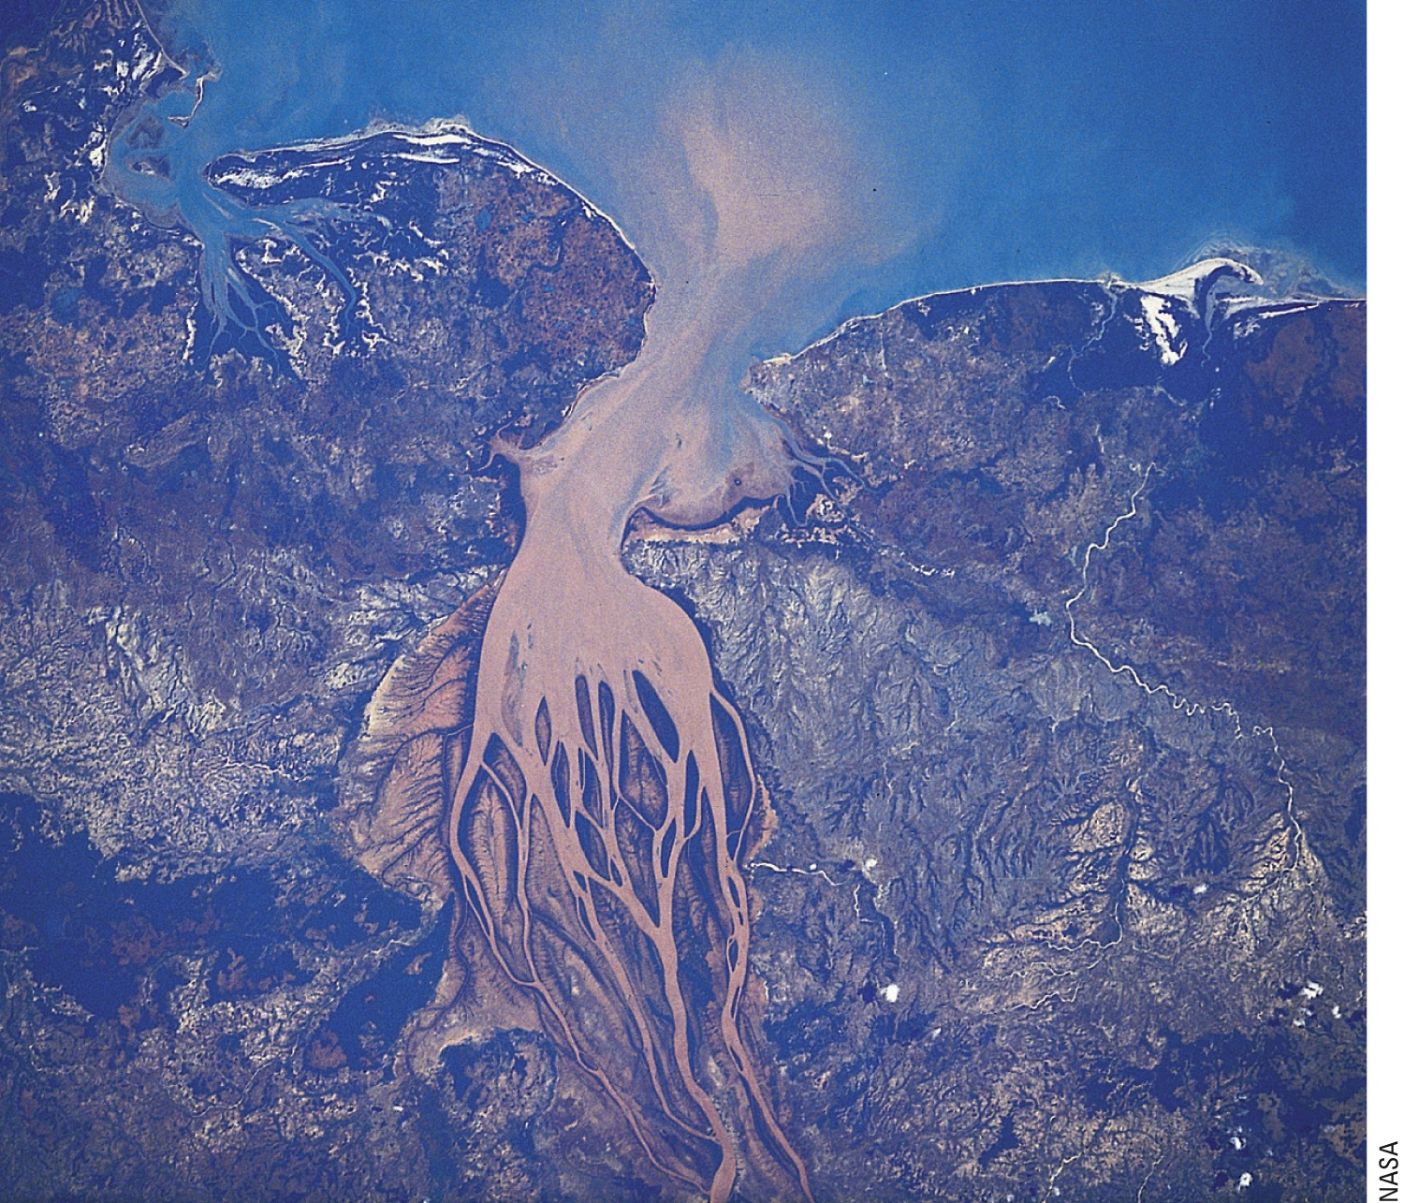
Fig. 8-7, p. 172
Notes:
Figure 8-7: This satellite photo shows a view of an estuary taken from space. A sediment plume (turbidity caused by runoff) forms at the mouth of Madagascar’s Betsiboka River as it flows through the estuary and into the Mozambique Channel.

Slide 19
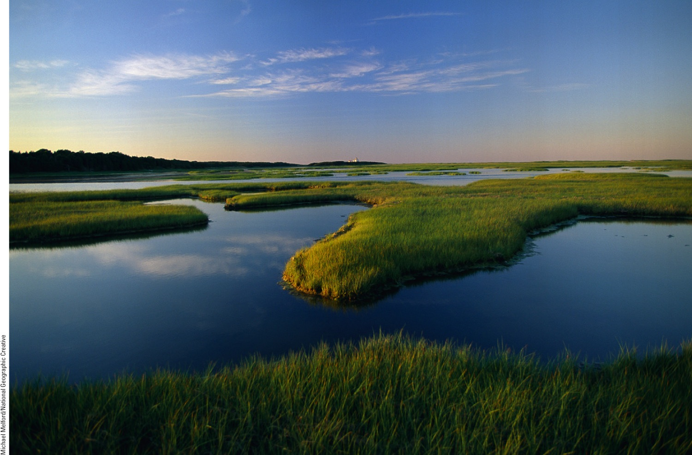
Fig. 8-8, p. 172
Notes:
Figure 8.8: This coastal marsh is located on Cape Cod, Massachusetts (USA).

Slide 20
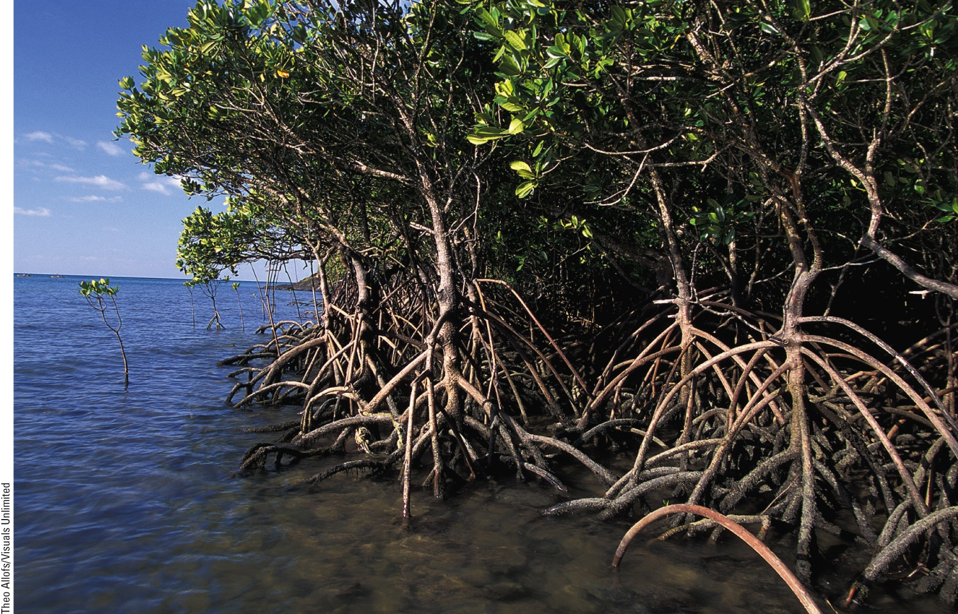
Fig. 8-9, p. 172
Notes:
Figure 8-9: This is a mangrove forest on the coast of Queensland, Australia.

Slide 21
Rocky and Sandy Shores Host Different Types of Organisms
Intertidal zone
Area of shore between high and low tides
Rocky shore
Sandy shore, barrier beach
Organism adaptations necessary to deal with daily salinity and moisture changes
What is the importance of sand dunes in this type of ecosystem?

Slide 22
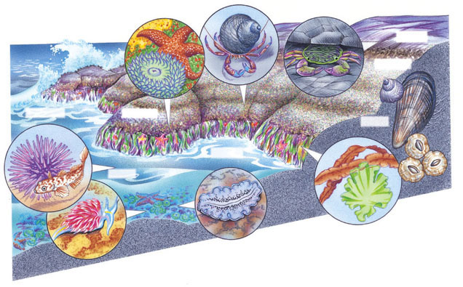
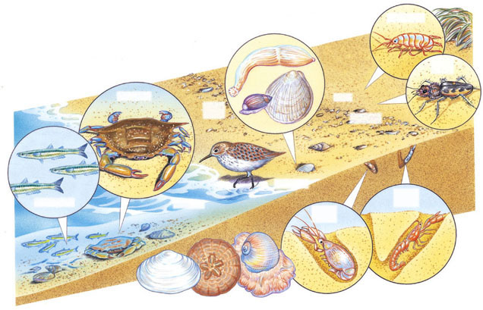
Sea star
Hermit crab
Shore crab
Rocky Shore Beach
High tide
Periwinkle
Sea urchin
Anemone
Mussel
Low tide
Sculpin
Barnacles
Kelp
Sea lettuce
Monterey flatworm
Beach flea
Peanut worm
Tiger beetle
Nudibranch
Barrier Beach
Blue crab
Clam
Dwarf olive
High tide
Sandpiper
Silversides
Low tide
Ghost shrimp
Mole shrimp
White sand macoma
Sand dollar
Moon snail
Stepped Art
Fig. 8-11, p. 180
Notes:
Figure 8-11: Living between the tides: Some organisms with specialized niches are found in various zones on rocky shore beaches (top) and barrier or sandy beaches (bottom). Organisms are not drawn to scale.

Slide 23
Coral Reefs Are Amazing Centers of Biodiversity
Marine equivalent of tropical rain forests
Reefs are being destroyed and damaged worldwide
Ocean acidification
Oceans absorb CO₂
CO₂ reacts with ocean water to form a weak acid that decreases levels of carbonate ions (CO₃²⁻) needed to form coral

Slide 24
The Open Sea and the Ocean Floor Host a Variety of Species
Three vertical zones of the open sea
Euphotic zone
Phytoplankton
Nutrient levels low
Dissolved oxygen levels high
Upwelling brings nutrients from below
Bathyal zone
Dimly lit
Zooplankton and smaller fishes

Slide 25
The Open Sea and the Ocean Floor Host a Variety of Species (cont’d.)
Abyssal zone
Dark and cold
High levels of nutrients
Little dissolved oxygen
Deposit feeders
Filter feeders
NPP low in the open sea
Except in upwelling areas

Slide 26
8-3 How Have Human Activities Affected Marine Ecosystems?
Human activities
Threaten aquatic biodiversity
Disrupt ecosystem and economic services provided by saltwater systems

Slide 27
Human Activities Are Disrupting and Degrading Marine Systems
Major threats to marine systems include:
Coastal development
Overfishing; use of fishing trawlers
Runoff of nonpoint source pollution
Point source pollution
Habitat destruction
Introduction of invasive species
Pollution of coastal wetlands and estuaries

Slide 28
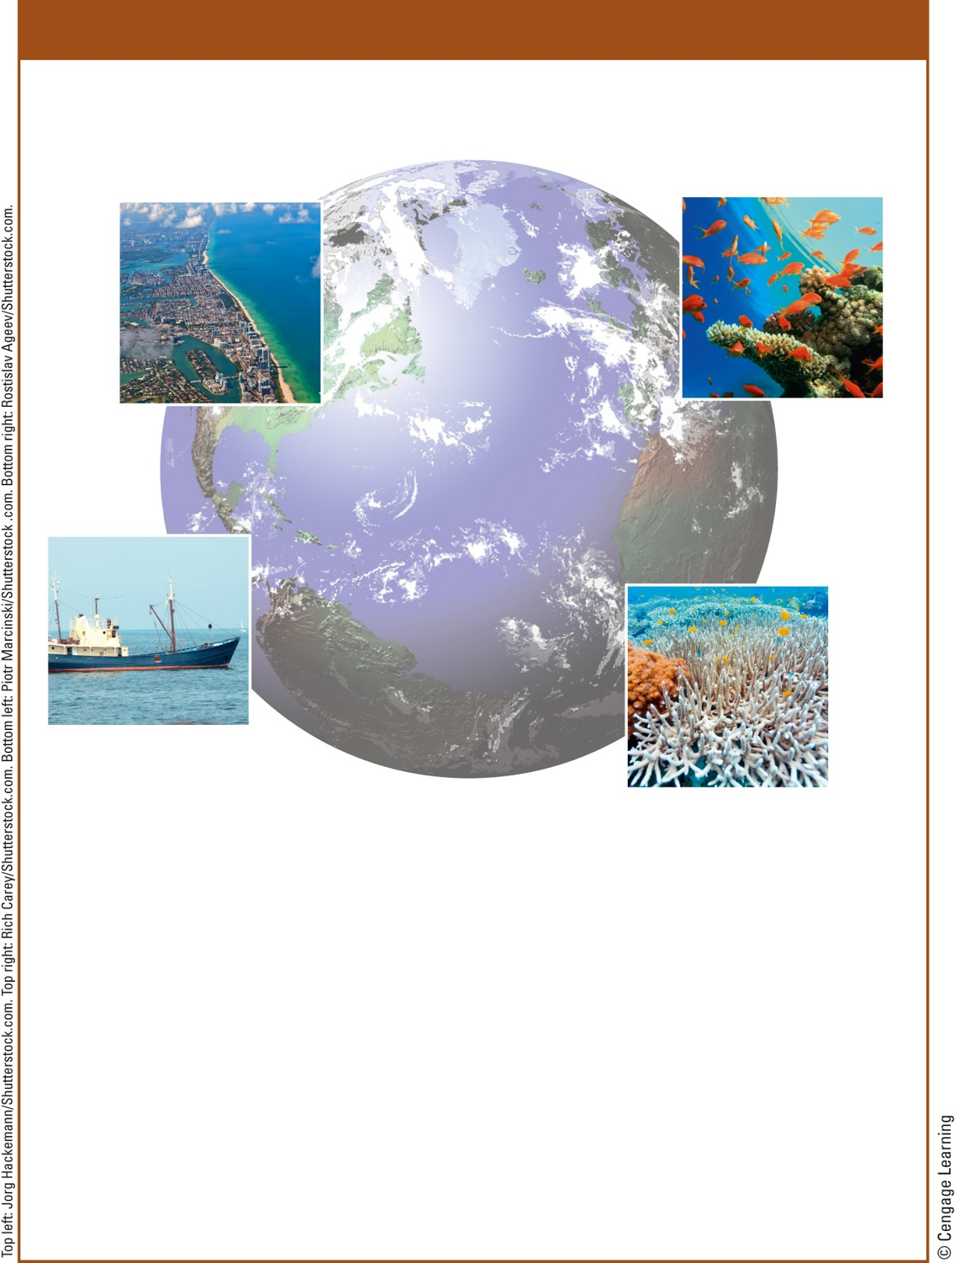
Natural Capital Degradation
Major Human Impacts on Marine Ecosystems and Coral Reefs
Marine Ecosystems
Coral Reefs
Half of coastal wetlands lost to agriculture and urban development
Ocean warming
Rising ocean acidity
Over one-fifth of mangrove forests lost to agriculture, aquaculture, and development
Soil erosion
Algae growth from fertilizer runoff
Beaches eroding due to development and rising sea levels
Bleaching
Ocean bottom habitats degraded by dredging and trawler fishing
Rising sea levels
Increased UV exposure
At least 20% of coral reefs severely damaged and 25–33% more threatened
Damage from anchors
and from fishing and diving
Fig. 8-12, p. 176
Notes:
Figure 8-12: Human activities are having major harmful impacts on all marine ecosystems (left) and particularly on coral reefs (right) (Concept 8-3). Questions: Which two of the threats to marine ecosystems do you think are the most serious? Why? Which two of the threats to coral reefs do you think are the most serious? Why?

Slide 29
Case Study: The Chesapeake Bay – an Estuary in Trouble
Largest estuary in the U.S.
Polluted since 1960
Large population increase
Point and nonpoint sources raised pollution
Phosphate and nitrate levels too high
Excess sediments from runoff and decreased vegetation

Slide 30
Case Study: The Chesapeake Bay – an Estuary in Trouble (cont’d.)
Oysters, a keystone species, greatly reduced
1983: Chesapeake Bay Program
Integrated coastal management with local, state, and federal governments, as well as citizens’ groups
2008 update:
25 years and $6 billion
Program failed to meet goals
Notes:
30

Slide 31
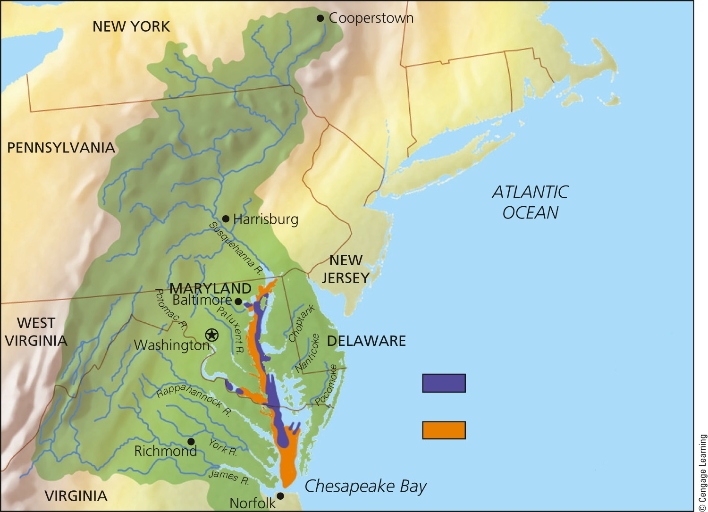
Drainage basin
No oxygen
Low concentrations of oxygen
Fig. 8-13, p. 177
Notes:
Figure 8-13: The Chesapeake Bay is severely degraded as a result of water pollution and atmospheric deposition of air pollutants.

Slide 32
8-4 Why Are Freshwater Ecosystems Important?
Freshwater ecosystems
Provide major ecosystem and economic services
Are irreplaceable reservoirs of biodiversity

Slide 33
Water Stands in Some Freshwater Systems and Flows in Others
Standing (lentic) bodies of freshwater
Lakes
Ponds
Inland wetlands
Flowing (lotic) systems of freshwater
Streams
Rivers

Slide 34
Water Stands in Some Freshwater Systems and Flows in Others (cont’d.)
Lakes have four zones based on depth and distance from shore
Littoral zone
Near shore where rooted plants grow; high biodiversity
Turtles, frogs, crayfish, some fish
Limnetic zone
Open, sunlight area away from shore; main photosynthetic zone
Some larger fish

Slide 35
Water Stands in Some Freshwater Systems and Flows in Others (cont’d.)
Profundal zone
Deep water too dark for photosynthesis
Low oxygen levels
Some fish
Benthic zone
Decomposers
Detritus feeders
Some fish
Nourished primarily by dead matter

Slide 36
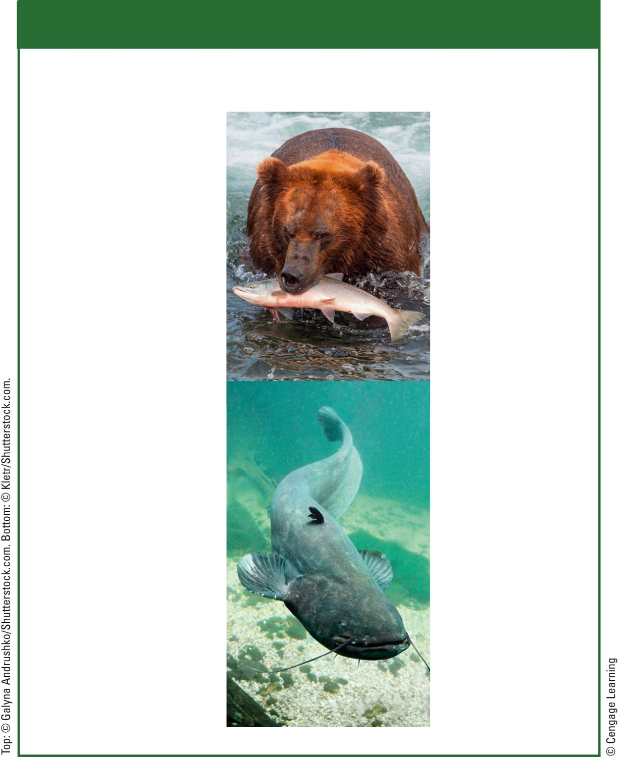
Natural Capital
Freshwater Systems
Ecological Services
Economic Services
Climate moderation
Food
Nutrient cycling
Drinking water
Waste treatment
Irrigation water
Flood control
Hydroelectricity
Groundwater recharge
Transportation corridors
Habitats for many species
Genetic resources and biodiversity
Recreation
Employment
Scientific information
Fig. 8-14, p. 178
Notes:
Figure 8-14: Freshwater systems provide many important ecosystem and economic services (Concept 8-4). Questions: Which two ecosystem services and which two economic services do you think are the most important? Why?

Slide 37
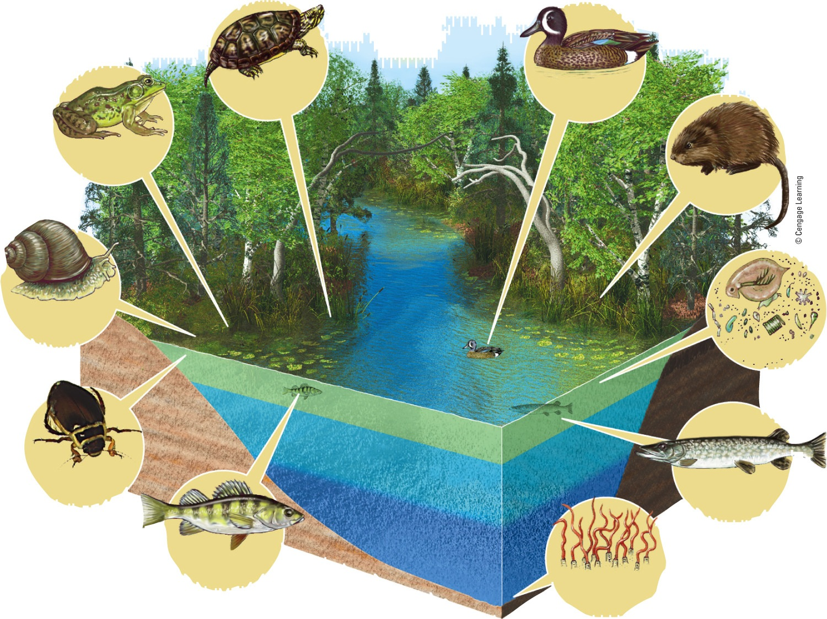
Painted turtle
Blue-winged teal
Green frog
Muskrat
Pond snail
Littoral zone
Plankton
Limnetic zone
Profundal zone
Diving beetle
Northern pike
Benthic zone
Yellow perch
Bloodworms
Fig. 8-16, p. 179
Notes:
Figure 8-16: This diagram illustrates the distinct zones of life in a fairly deep temperate-zone lake. Question: How are deep lakes like tropical rain forests? (Hint: See Figure 7-14, p. 157.)

Slide 38
Some Lakes Have More Nutrients Than Others
Oligotrophic lakes
Low levels of nutrients and low NPP
Very clear water
Eutrophic lakes
High levels of nutrients and high NPP
Murky water with high turbidity
Cultural eutrophication of lakes from human input of nutrients

Slide 39
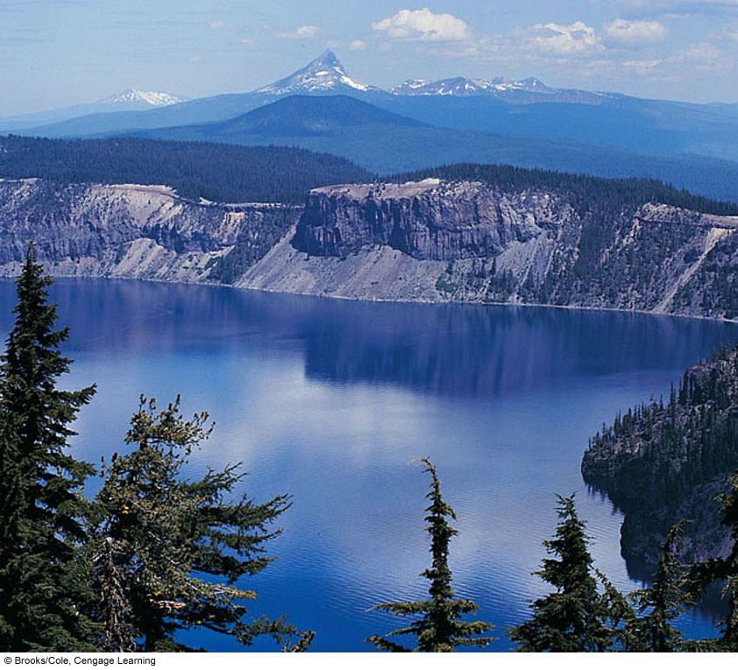
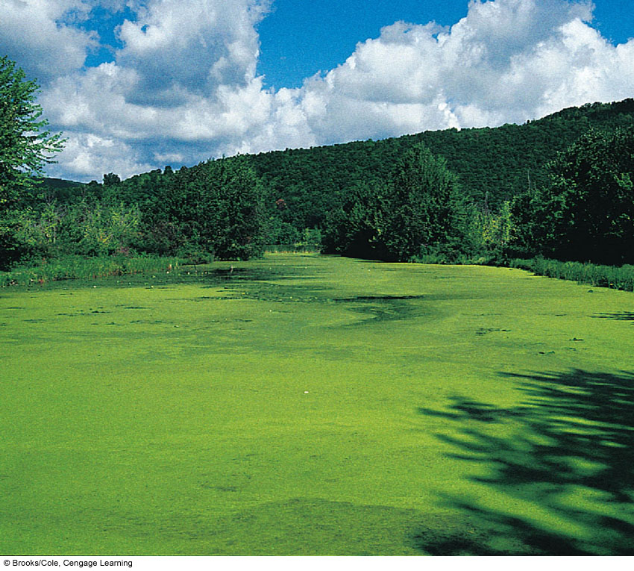
Stepped Art
Fig 8-15, 8-17; p. 179-180
Notes:
Figure 8-15: Crater Lake, in the U.S. state of Oregon, formed in the crater of an extinct volcano.
Figure 8-17: This eutrophic lake, found in western New York State, has received large flows of plant nutrients. As a result, its surface is covered with mats of algae.

Slide 40
Freshwater Streams and Rivers Carry Large Volumes of Water
Surface water
Runoff
Downward flow of water from mountains
Three aquatic life zones
Source zone
Shallow, cold, clear, swiftly flowing
High dissolved oxygen

Slide 41
Freshwater Streams and Rivers Carry Large Volumes of Water
Transition zone
Wider, deeper, warmer streams
More turbid
Less dissolved oxygen
Floodplain zone
Wide, deep rivers
Broad, flat valleys

Slide 42
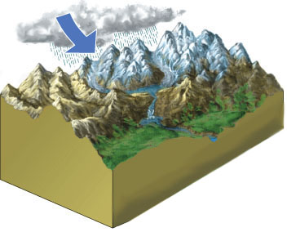
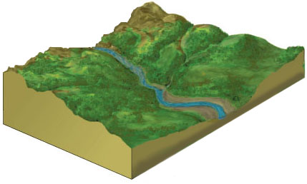
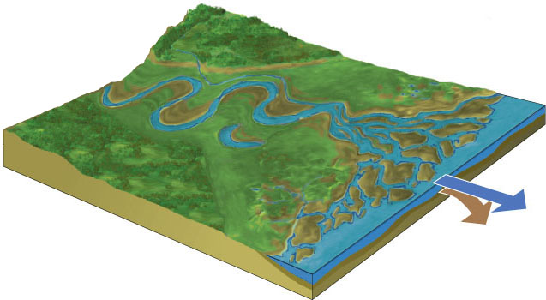
Rain and snow
Lake
Glacier
Rapids
Waterfall
Tributary
Flood plain
Oxbow lake
Salt marsh
Delta
Deposited sediment
Ocean
Source Zone
Transition Zone
Water
Sediment
Floodplain Zone
Stepped Art
Fig. 8-18, p. 180
Notes:
Figure 8-18: There are three zones in the downhill flow of water: the source zone, which contains headwater streams found in highlands and mountains (see photo inset); the transition zone, which contains wider, lower-elevation streams; and the floodplain zone, which contains rivers that empty into larger rivers or into the ocean.

Slide 43
Case Study: River Deltas and Coastal Wetlands
Coastal deltas, mangrove forests, and coastal wetlands provide natural protection against storms
Dams and levees reduce sediments in deltas
Subsidence of New Orleans
Rising sea levels will inundate coastal areas

Slide 44
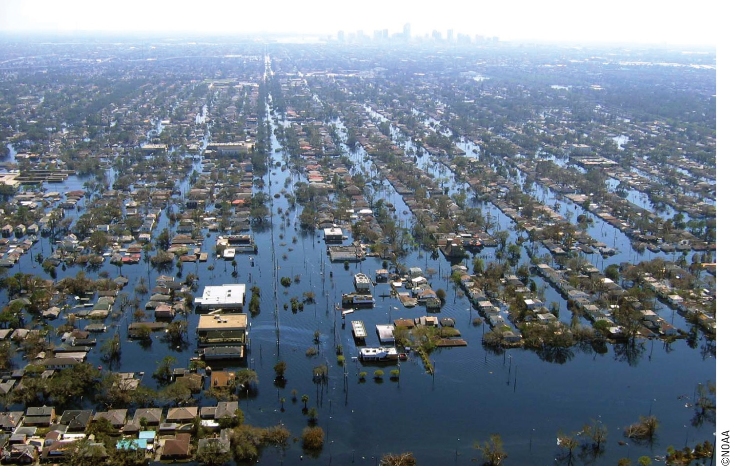
Fig. 8-19, p. 182
Notes:
Figure 8-19: Much of the U.S. city of New Orleans, Louisiana, was flooded by the storm surge that accompanied Hurricane Katrina, which made landfall just east of the city on August 29, 2005.

Slide 45
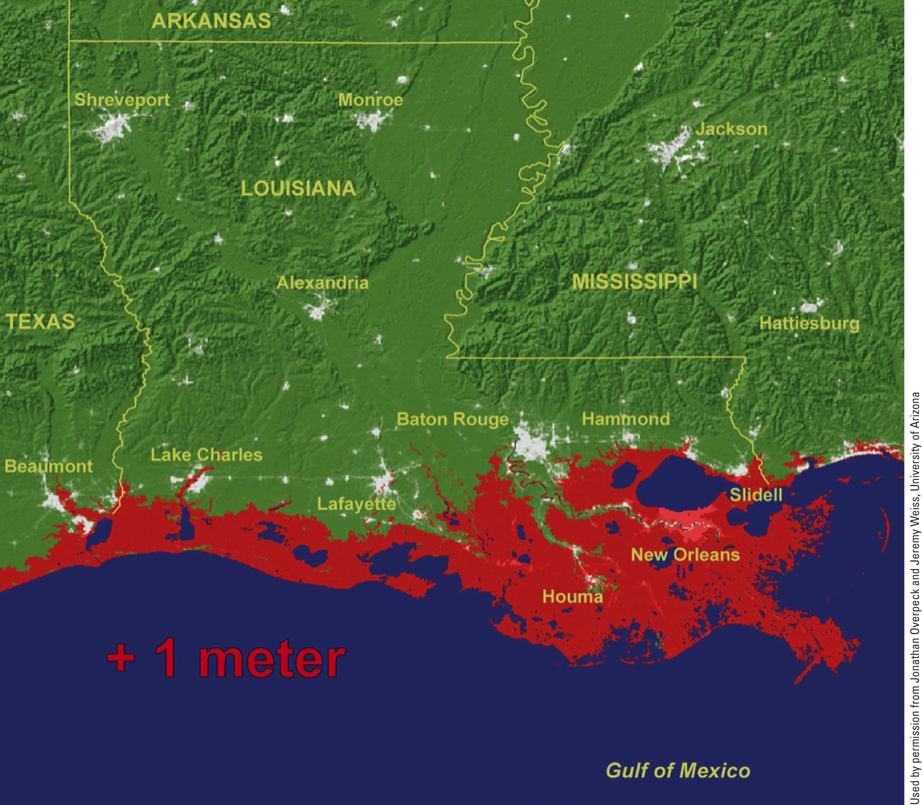
Fig. 8-20, p. 182
Notes:
Figure 8-20: The areas in red represent projected coastal flooding that would result from a 1-meter (3-foot) rise in sea level due to projected climate change by the end of this century.

Slide 46
Freshwater Inland Wetlands Are Vital Sponges
Inland wetlands
Lands located away from coasts that are covered with freshwater all or part of the time
Include:
Marshes, swamps, prairie potholes, floodplains, and arctic tundra

Slide 47
Freshwater Inland Wetlands Are Vital Sponges (cont’d.)
Provide free ecosystem and economic services
Filter and degrade toxic wastes
Reduce flooding and erosion
Help to replenish streams and recharge groundwater aquifers
Biodiversity
Food and timber
Recreation areas

Slide 48
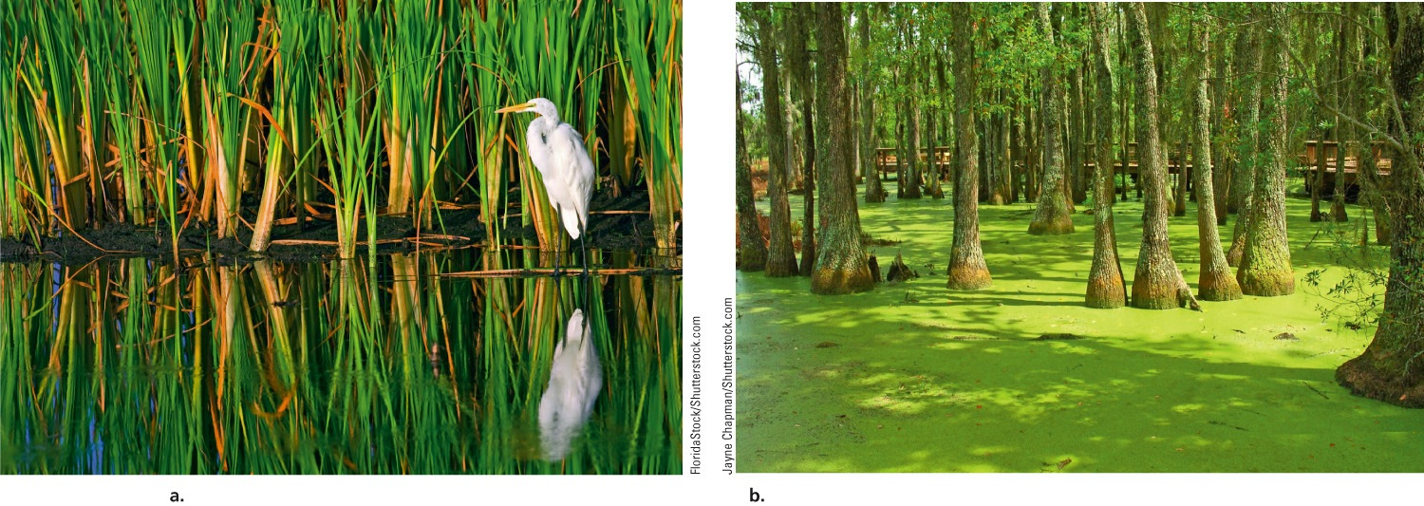
Fig. 8-21, p. 184
Notes:
Figure 8-21: This great white egret lives in an inland marsh in the Florida Everglades (left). This cypress swamp (right) is located in South Carolina.

Slide 49
8-5 How Have Human Activities Affected Freshwater Ecosystems?
Human activities
Threaten and disrupt ecosystem and economic services provided by freshwater lakes, rivers, and wetlands

Slide 50
Human Activities Are Disrupting and Degrading Freshwater Systems
Dams and canals restrict the flows of rivers
40% of the world’s largest rivers
Flood-control destroys aquatic habitats and alters wetlands
Cities and farms pollute water
Many wetlands have been drained for human purposes

Slide 51
Three Big Ideas
Water dominates the planet
Saltwater and freshwater aquatic life zones cover almost three-fourths of the earth’s surface
The earth’s aquatic systems provide important ecosystem and economic services

Slide 52
Three Big Ideas (cont’d.)
Human activities threaten biodiversity and disrupt ecological and economic services provided by aquatic systems

Slide 53
Tying It All Together: Coral Reefs and Sustainability
Coral reefs:
Thrive on solar energy
Participate in nutrient cycling
Sustain aquatic biodiversity
In nature, everything is connected
How can we can reduce harm to coral reefs?

