Slide 1
5
Biodiversity, Species Interactions, and Population Control

Slide 2
5-2 Responding to Changing Environmental Conditions
How do communities and ecosystems respond to changing environmental conditions?
The structure and species composition of communities and ecosystems change in response to changing environmental conditions through a process called ecological succession

Slide 3
Communities and Ecosystems Change over Time: Ecological Succession
Ecological succession
Gradual change in species composition
Primary succession
In lifeless areas
Secondary succession
Areas of environmental disturbance
Examples of natural ecological restoration

Slide 4
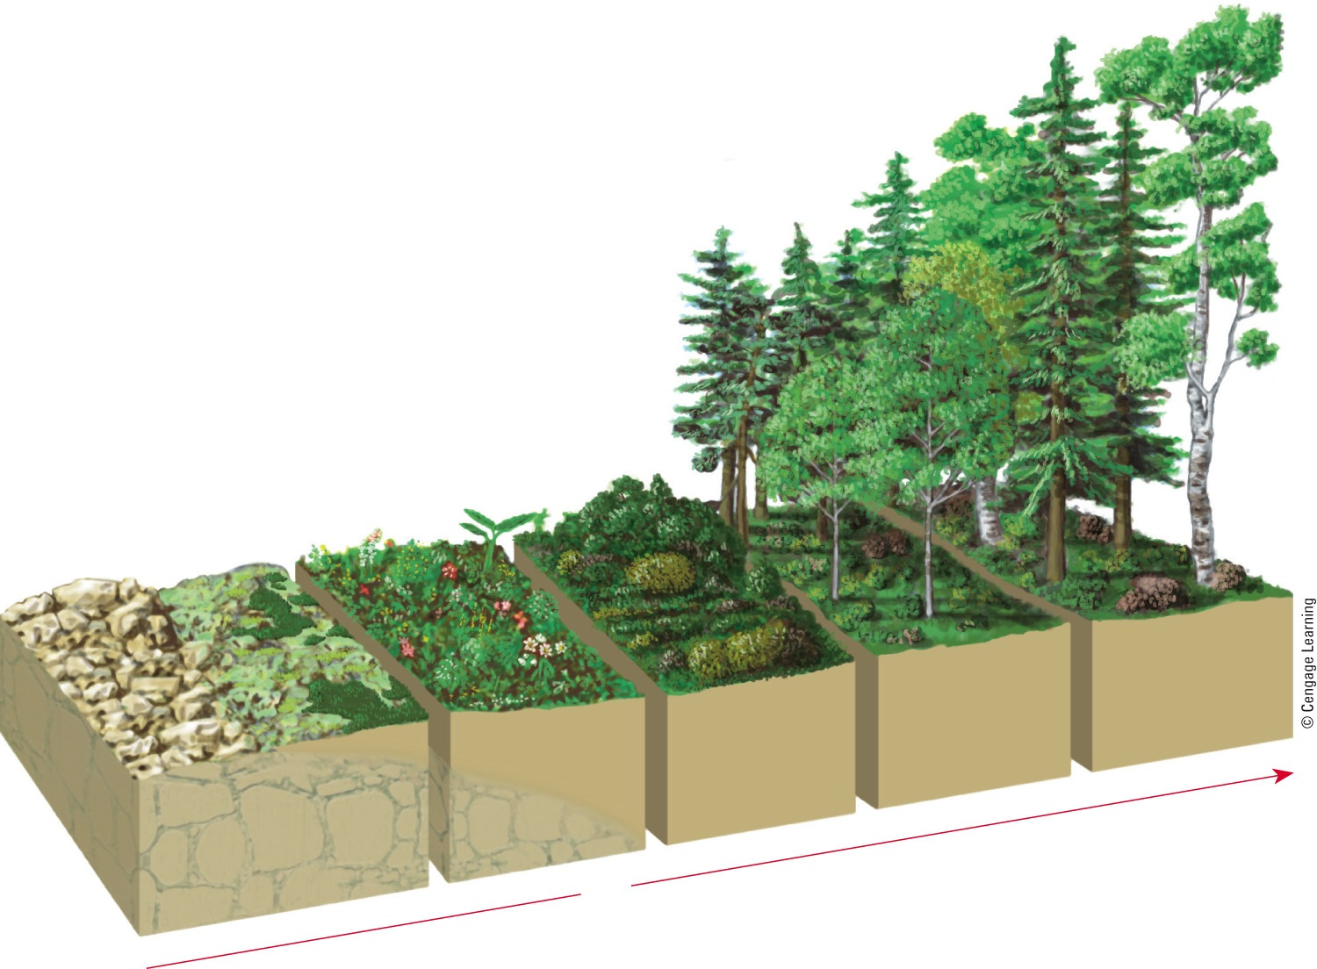
Primary Ecological Succession
Balsam fir, paper birch, and white spruce forest community
Jack pine, black spruce, and aspen
Small herbs and shrubs
Heath mat
Lichens and mosses
Exposed rocks
Time
Fig. 5-11, p. 109
Notes:
Figure 5.11 Primary ecological succession: Over almost a 1,000 years, these plant communities developed, starting on bare rock exposed by a retreating glacier on Isle Royal, Michigan (USA) in western Lake Superior. The details of this process vary from one site to another.

Slide 5
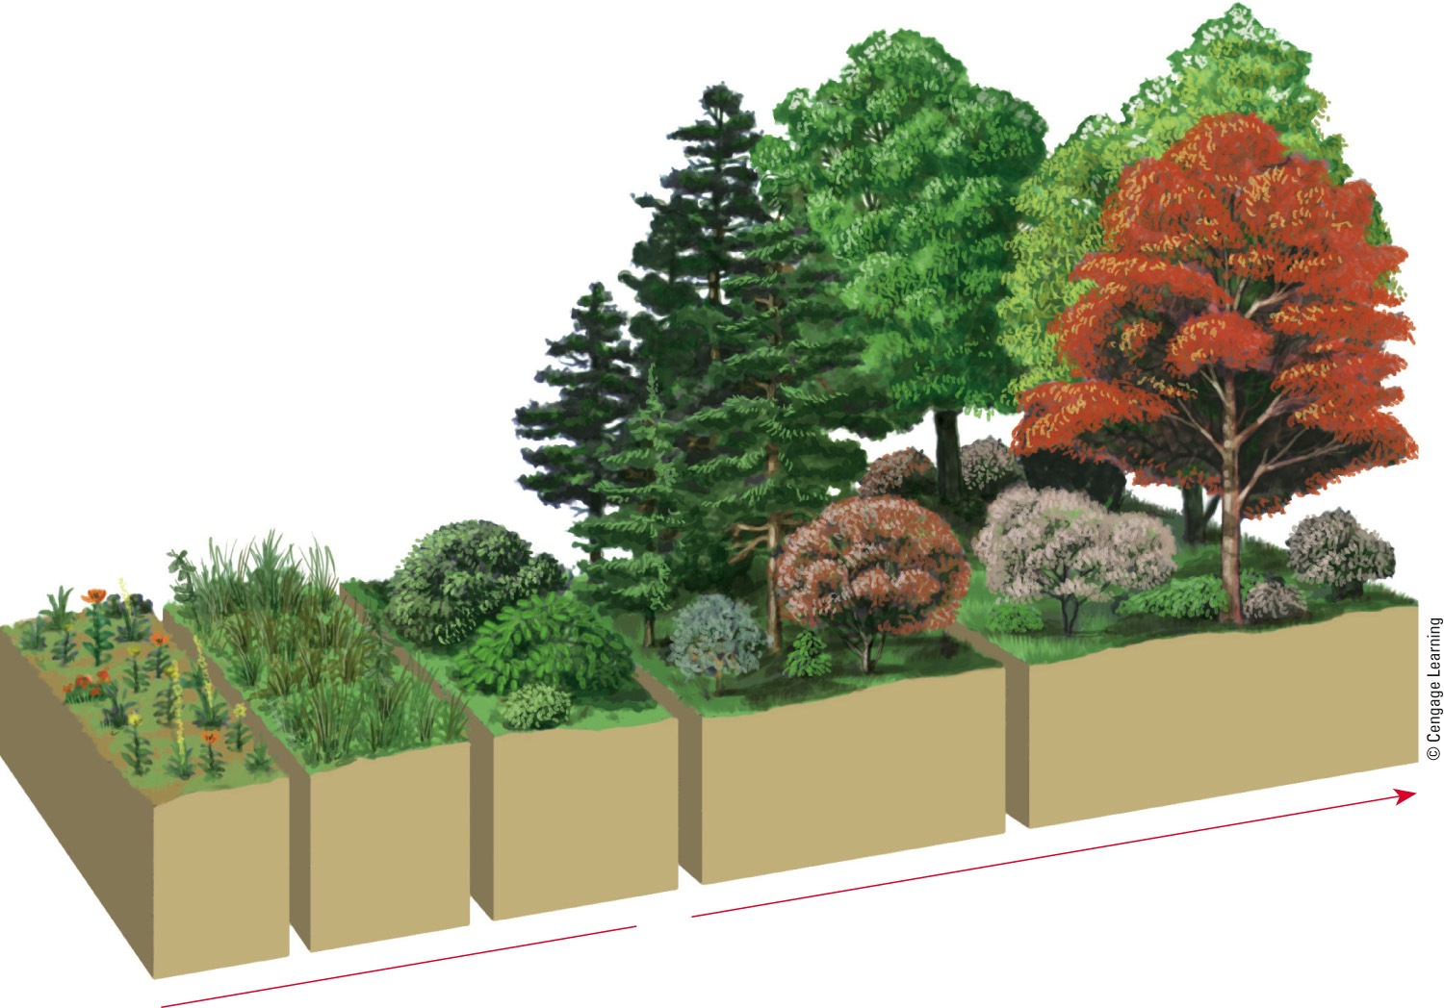
Natural Ecological Restoration
Mature oak and hickory forest
Young pine forest with developing understory of oak and hickory trees
Perennial weeds and grasses
Shrubs and small pine seedlings
Annual weeds
Time
Fig. 5-12, p. 110
Notes:
Animated Figure 5.12 Natural ecological restoration of disturbed land: This diagram shows the undisturbed secondary ecological succession of plant communities on an abandoned farm field in the U.S. state of North Carolina. It took 150–200 years after the farmland was abandoned for the area to become covered with a mature oak and hickory forest.

Slide 6
Ecological Succession Does Not Follow a Predictable Path
Traditional view
Balance of nature and climax communities
Current view
Ever-changing mosaic of patches of vegetation in different stages of succession

Slide 7
Living Systems Are Sustained through Constant Change
Inertia
Ability of a living system to survive moderate disturbances
Resilience
Ability of a living system to be restored through secondary succession after a moderate disturbance

Slide 8
What Limits the Growth of Populations
No population can grow indefinitely because of limitations on resources and because of competition among species for those resources

Slide 9
Most Populations Live in Clumps
Population
Group of interbreeding individuals of the same species
Population distribution
Clumping
Species cluster for resources
Protection from predators
Ability to hunt in packs

Slide 10
A School of Anthias Fish
Fig. 5-13, p. 111
Notes:
Figure 5-13: A population, or school, of Anthias fish on coral in Australia’s Great Barrier Reef.

Slide 11
Populations Can Grow, Shrink, or Remain Stable
Population size governed by:
Births and deaths; immigration and emigration
Population change = (births + immigration) – (deaths + emigration)
Age structure
Pre-reproductive age
Reproductive age
Post-reproductive age

Slide 12
Some Factors Can Limit Population Size
Range of tolerance
Variations in physical and chemical environment
Individuals may have different tolerance ranges

Slide 13
Some Factors Can Limit Population Size
Limiting factor principle
Too much or too little of any physical or chemical factor can limit or prevent growth of a population, even if all other factors are at or near the optimal range of tolerance
Precipitation, nutrients, sunlight
Populations density
Number of individuals in a given area

Slide 14
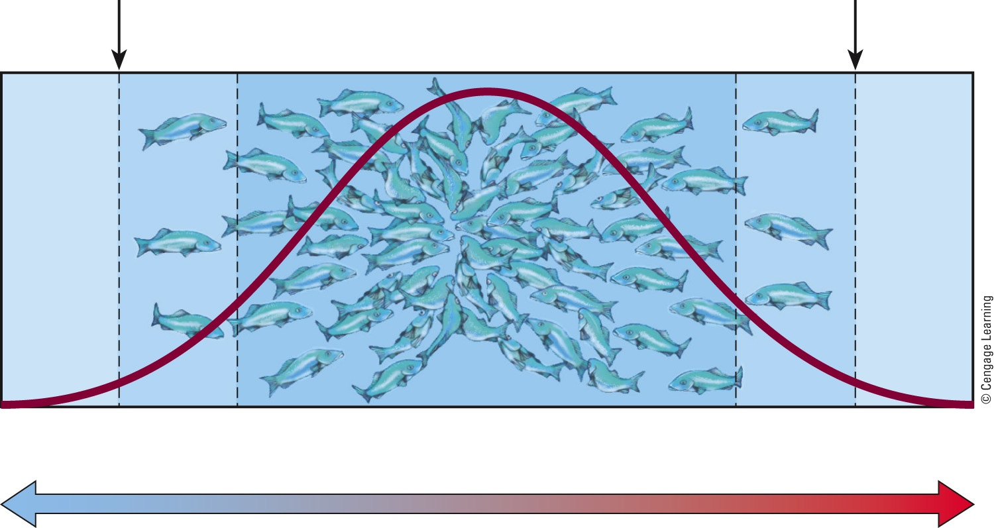
Trout Tolerance of Temperature
Lower limit
of tolerance
Higher limit
of tolerance
No organisms
Few organisms
Few organisms
No organisms
Abundance of organisms
Population size
Zone of intolerance
Zone of physiological stress
Optimum range
Zone of physiological stress
Zone of intolerance
Low
Temperature
High
Fig. 5-13, p. 113
Notes:
Figure 5.15 Range of tolerance for a population of trout to changes in water temperature.

Slide 15
Different Species Have Different Reproductive Patterns
Some species:
Have many small offspring
Little parental involvement
Other species:
Reproduce later in life
Have small number of offspring

Slide 16
No Population Can Grow Indefinitely: J-Curves and S-Curves
There are always limits to population growth in nature
Environmental resistance – factors that limit population growth
Carrying capacity
Maximum population of a given species that a particular habitat can sustain indefinitely

Slide 17
No Population Can Grow Indefinitely: J-Curves and S-Curves (cont’d.)
Exponential growth
At a fixed percentage per year
Logistic growth
Population faces environmental resistance

Slide 18
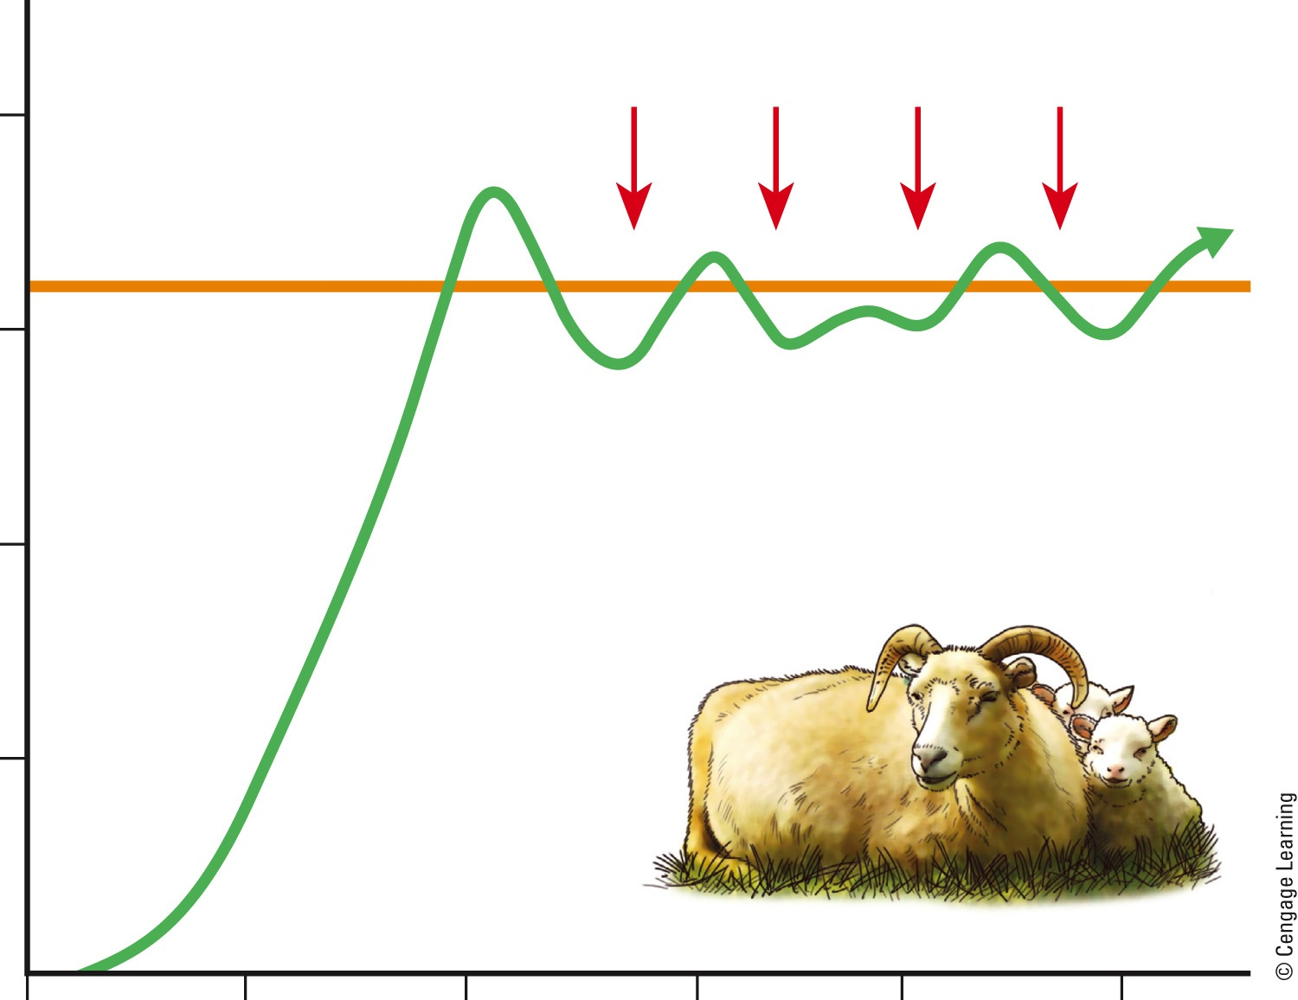
Growth of a Sheep Population
Population overshoots carrying capacity
Environmental resistance
2.0
Carrying capacity
1.5
Population recovers and stabilizes
Number of sheep (millions)
1.0
Population runs out of resources and crashes
Exponential growth
.5
1800
1825
1850
1875
1900
1925
Year
Fig. 5-16, p. 115
Notes:
Animated Figure 5.16 Growth of a sheep population on the island of Tasmania between 1800 and 1925. After sheep were introduced in 1800, their population grew exponentially thanks to an ample food supply and few predators. By 1855, they had overshot the land’s carrying capacity. Their numbers then stabilized and fluctuated around a carrying capacity of about 1.6 million sheep.

Slide 19
Case Study: Exploding White-Tailed Deer Population in the U.S.
1900 – deer habitat destruction and uncontrolled hunting
1920s–1930s – laws to protect the deer
Current deer population explosion
Spread Lyme disease
Deer-vehicle accidents
Eating garden plants and shrubs
How can we control the deer population?

Slide 20
White-Tailed Deer Populations
Fig. 5-17, p. 115
Notes:
Figure 5-17: White-tailed deer populations in the United States have been growing.

Slide 21
When a Population Exceeds Its Carrying Capacity It Can Crash
A population exceeds the area’s carrying capacity
Reproductive time lag may lead to overshoot
Subsequent population crash
Damage may reduce area’s carrying capacity

Slide 22
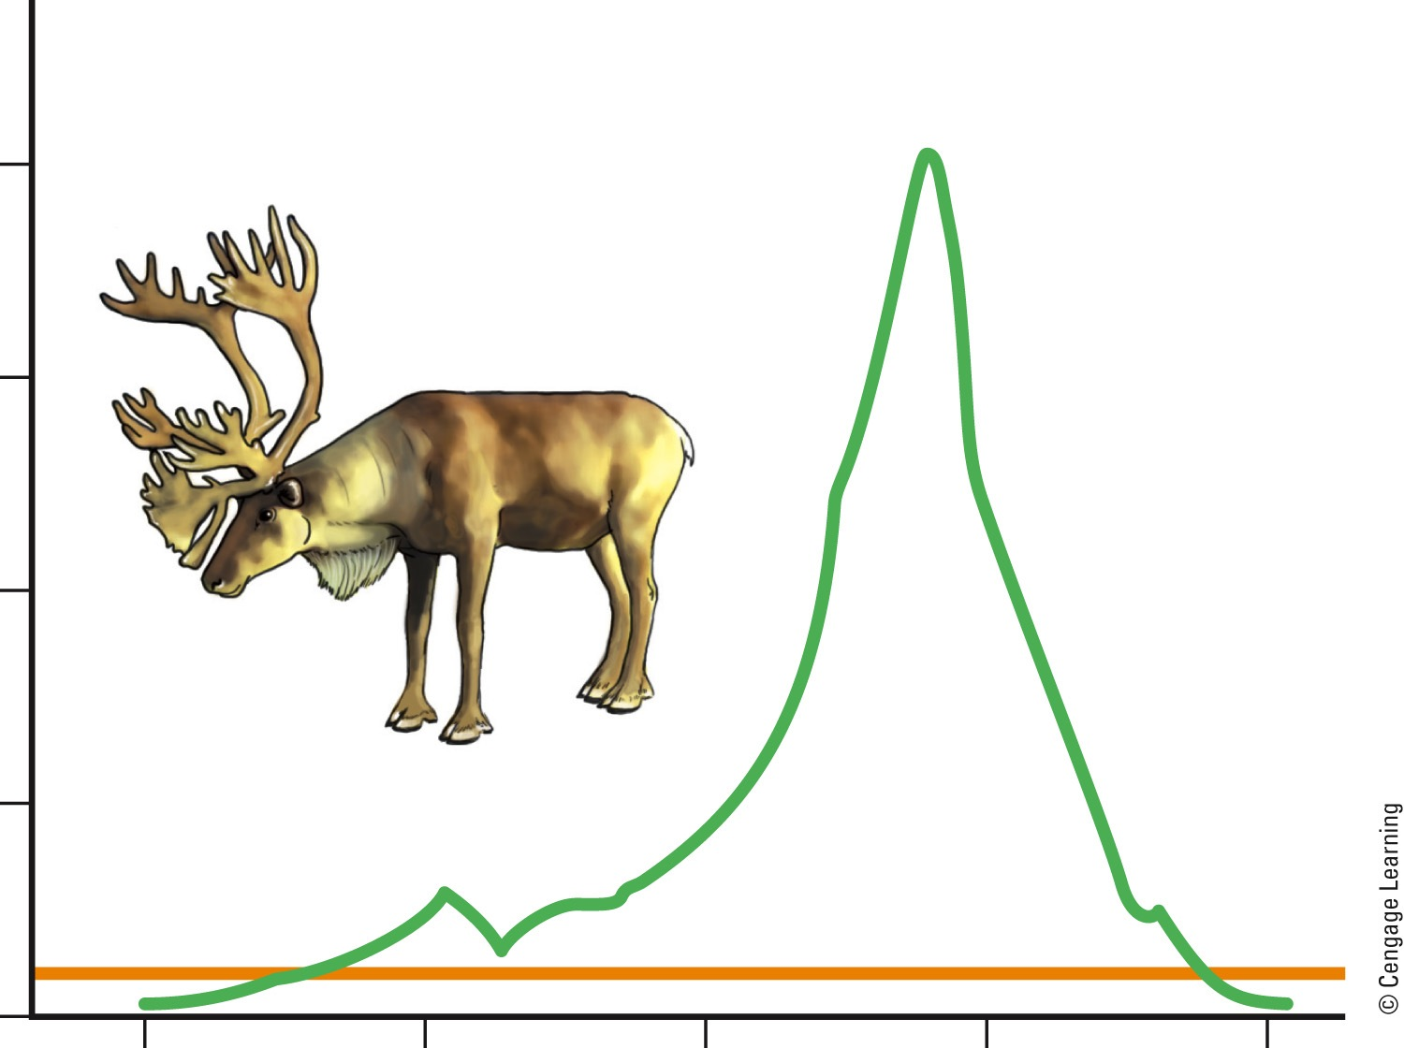
Population Crash
2,000
Population overshoots carrying capacity
1,500
Population crashes
Number of reindeer
1,000
500
Carrying capacity
0
1910
1920
1930
1940
1950
Year
Fig. 5-18, p. 116
Notes:
Figure 5.18 Exponential growth, overshoot, and population crash of reindeer introduced onto the small Bering Sea island of St. Paul in 1910.

Slide 23
Humans Are Not Exempt from Nature’s Population Controls
Ireland
Potato crop in 1845
Bubonic plague
Fourteenth century
AIDS
Current global epidemic

Slide 24
Three Big Ideas
Certain interactions among species
Affect their use of resources and their population sizes
Changes in environmental conditions
Cause communities and ecosystems to gradually alter their species composition and population sizes (ecological succession)
There are always limits to population growth in nature

Slide 25
Tying It All Together – Southern Sea Otters and Sustainability
Before European settlers in the U.S., the sea otter ecosystem was complex
Settlers began hunting otters
Disturbed the balance of the ecosystem
Populations depend on solar energy and nutrient cycling
When these are disrupted biodiversity is threatened

