Slide 1
4
Biodiversity and Evolution

Slide 2
Core Case Study: Why Are Amphibians Vanishing?
Rapid changes in land and water habitats
Most likely caused by humans
Amphibians:
Are sensitive biological indicators
Play important ecological roles in their communities
Are a genetic storehouse of pharmaceutical products waiting to be discovered

Slide 3
4-1 What Is Biodiversity and Why Is It Important?
The biodiversity found in genes, species, ecosystems, and ecosystem processes is vital to sustaining life on the earth

Slide 4
Biodiversity Is a Crucial Part of the Earth’s Natural Capital
Biodiversity – variety in the earth’s species
Species – set of individuals who can mate and produce fertile offspring
8 million to 100 million species
About 2 million identified
Unidentified species are mostly in rain forests and oceans

Slide 5
Biodiversity Is a Crucial Part of the Earth’s Natural Capital (cont’d.)
Species diversity
Number and variety of species
Genetic diversity
Variety of genes in a population
Ecosystem diversity
Biomes: regions with distinct climates/species

Slide 6
Biodiversity Is a Crucial Part of the Earth’s Natural Capital (cont’d.)
Functional diversity
Variety of processes within ecosystems
Biodiversity is an important part of natural capital

Slide 7
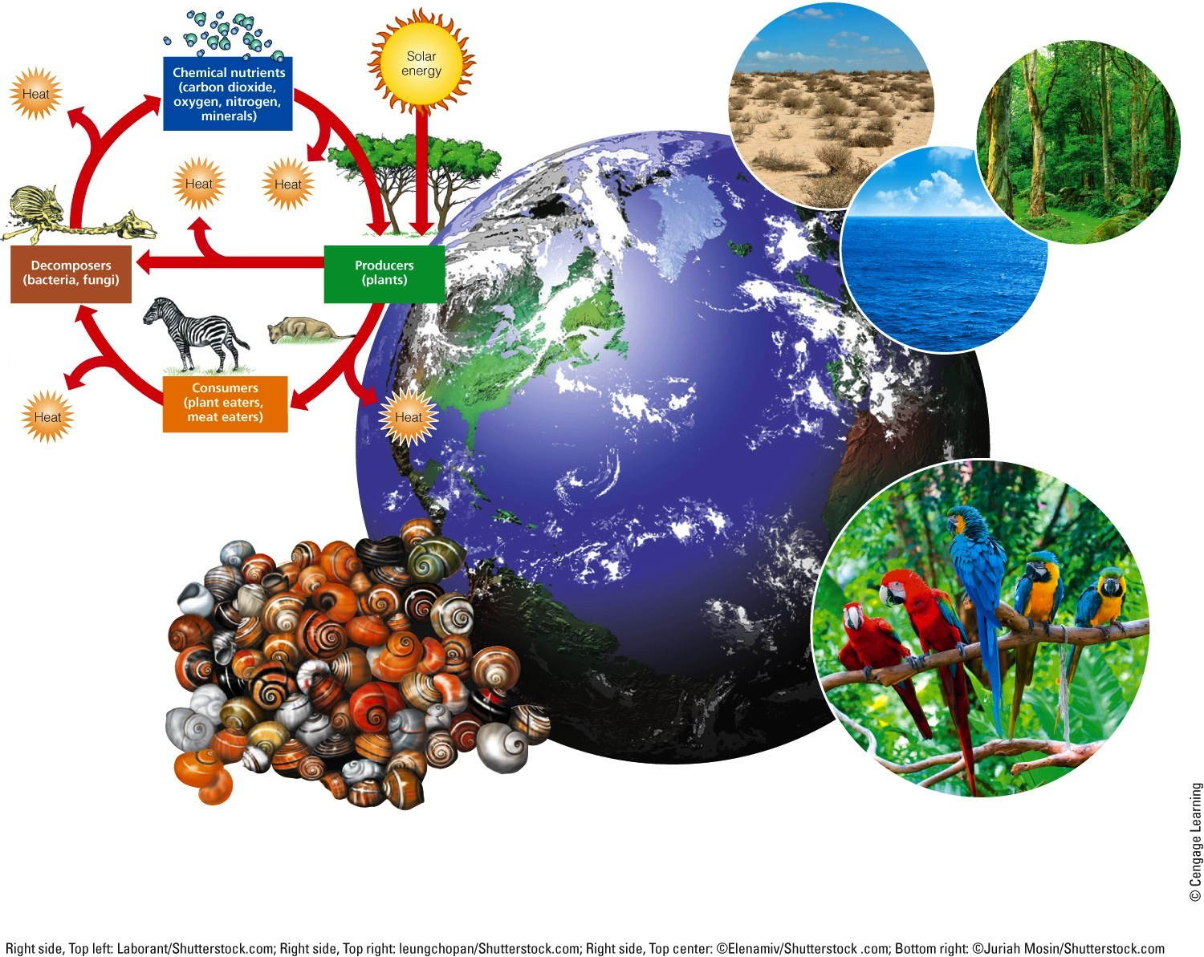
Functional Diversity The biological and chemical processes such as energy flow and matter recycling needed for the survival of species, communities, and ecosystems.
Ecological Diversity The variety of terrestrial and aquatic ecosystems found in an area or on the earth.
Genetic Diversity The variety
of genetic material within a
species or a population.
Species Diversity The number and abundance of species present in different communities.
Fig. 4-2, p. 79
Notes:
Figure 4.2 Natural capital: The major components of the earth’s biodiversity—one of the planet’s most important renewable resources and a key component of its natural capital (see Figure 1-3, p. 7). Question: Why do you think we should protect the earth’s biodiversity from our actions?

Slide 8
Genetic Diversity
Fig. 4-3, p. 81
Notes:
Figure 4-3: Genetic diversity among individuals in this population of a species of Caribbean snail is reflected in the variations in shell color and banding patterns. Genetic diversity can also include other variations such as slight differences in chemical makeup, sensitivity to various chemicals, and behavior.

Slide 9
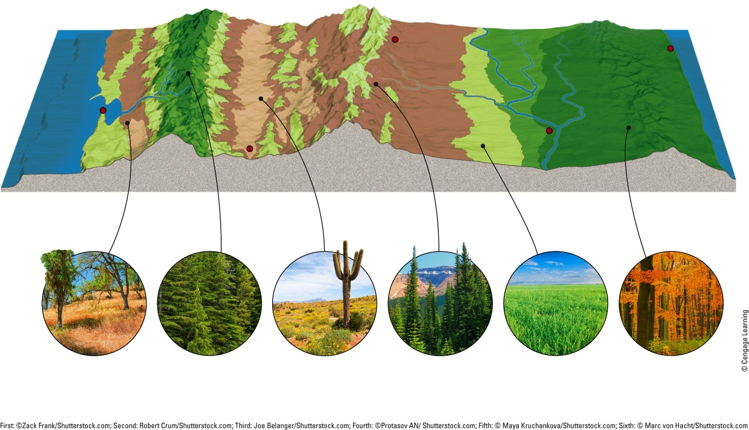
Major Biomes
Denver
Baltimore
San Francisco
Las Vegas
St. Louis
Coastal mountain ranges
Sierra Nevada
Great American Desert
Rocky Mountains
Great Plains
Mississippi River Valley
Appalachian Mountains
Coastal chaparral
and scrub
Coniferous forest
Desert
Coniferous forest
Prairie grassland
Deciduous forest
Fig. 4-4, p. 81
Notes:
Figure 4-4: The major biomes found along the 39th parallel across the United States show a variety of ecosystems. The differences in tree and other plant species reflect changes in climate, mainly differences in average annual precipitation and temperature.

Slide 10
4-2 How Does the Earth’s Life Change Over Time?
The scientific theory of evolution explains how life on earth changes over time through changes in the genes of populations
Populations evolve when genes mutate and give some individuals genetic traits that enhance their abilities to survive and to produce offspring with these traits (natural selection)

Slide 11
Biological Evolution by Natural Selection Explains How Life Changes over Time
Fossils
Physical evidence of ancient organisms
Reveal what their external structures looked like
Fossil record – entire body of fossil evidence
We only have fossils of 1% of all species that lived on earth

Slide 12
Fossilized Skeleton of an Herbivore that Lived during the Cenozoic Era
Fig. 4-5, p. 83
Notes:
Figure 4-5: This fossil shows the mineralized remains of an early ancestor of the present-day horse. It roamed the earth more than 35 million years ago. Note that you can also see fish skeletons on this fossil.

Slide 13
Biological Evolution by Natural Selection (cont’d.)
Biological evolution – how the earth’s life changes over time through changes in the genetic characteristics of populations
Darwin – Origin of Species
Natural selection – individuals with certain traits are more likely to survive and reproduce under a certain set of environmental conditions
Huge body of evidence

Slide 14
Mutations and Changes in the Genetic Makeup of Populations
Populations evolve by becoming genetically different
Genetic variations
First step in biological evolution
Occurs through mutations in reproductive cells
Mutations – random changes in DNA molecules

Slide 15
Mutations and Changes in the Genetic Makeup of Populations (cont’d.)
Natural selection: acts on individuals
Second step in biological evolution
Adaptation may lead to differential reproduction
Genetic resistance – ability of one or more members of a population to resist a chemical designed to kill it

Slide 16
(a)
(b)
(c)
(d)
Normal bacterium
Resistant bacterium
Stepped Art
Fig. 4-6, p. 84
Notes:
Figure 4.6 Evolution by natural selection. A population of bacteria (a) is exposed to an antibiotic, which (b) kills most individuals, but none of those possessing a trait that makes them resistant to the drug (shown in red). The resistant bacteria multiply (c) and eventually, (d) replace all or most of the nonresistant bacteria.

Slide 17
Case Study: How Did Humans Become Such a Powerful Species?
Three adaptations have helped the human species
Strong opposable thumbs
The ability to walk upright
Complex brain

Slide 18
Adaptation through Natural Selection Has Limits
Adaptive genetic traits must precede change in the environmental conditions
A population’s reproductive capacity
Species that reproduce rapidly and in large numbers are better able to adapt

Slide 19
Three Common Myths about Evolution through Natural Selection
Fitness is reproductive success, not strength
Organisms do not develop traits out of need or want
There is no grand plan of nature for perfect adaptation

Slide 20
4-3 How Do Geological Processes and Climate Change Affect Evolution?
Tectonic plate movements, volcanic eruptions, earthquakes, and climate change have shifted wildlife habitats, wiped out large numbers of species, and created opportunities for the evolution of new species

Slide 21
Geologic Processes Affect Natural Selection
Tectonic plates affect evolution and the location of life on earth
Locations of continents and oceans have shifted through geologic time
Species physically move, or adapt, or form new species through natural selection
Earthquakes – separate and isolate populations
Volcanic eruptions – destroy habitats

Slide 22
The Effect of Movement over Tectonic Plates
225 million years ago
Present
Fig. 4-9, p. 86
Notes:
Figure 4-9: Over millions of years, the earth’s continents have moved very slowly on several gigantic tectonic plates. Question: How might an area of land splitting apart cause the extinction of a species?

Slide 23
Climate Change and Catastrophes Affect Natural Selection
Ice ages followed by warming temperatures
Collisions between the earth and large asteroids
New species
Extinctions

Slide 24
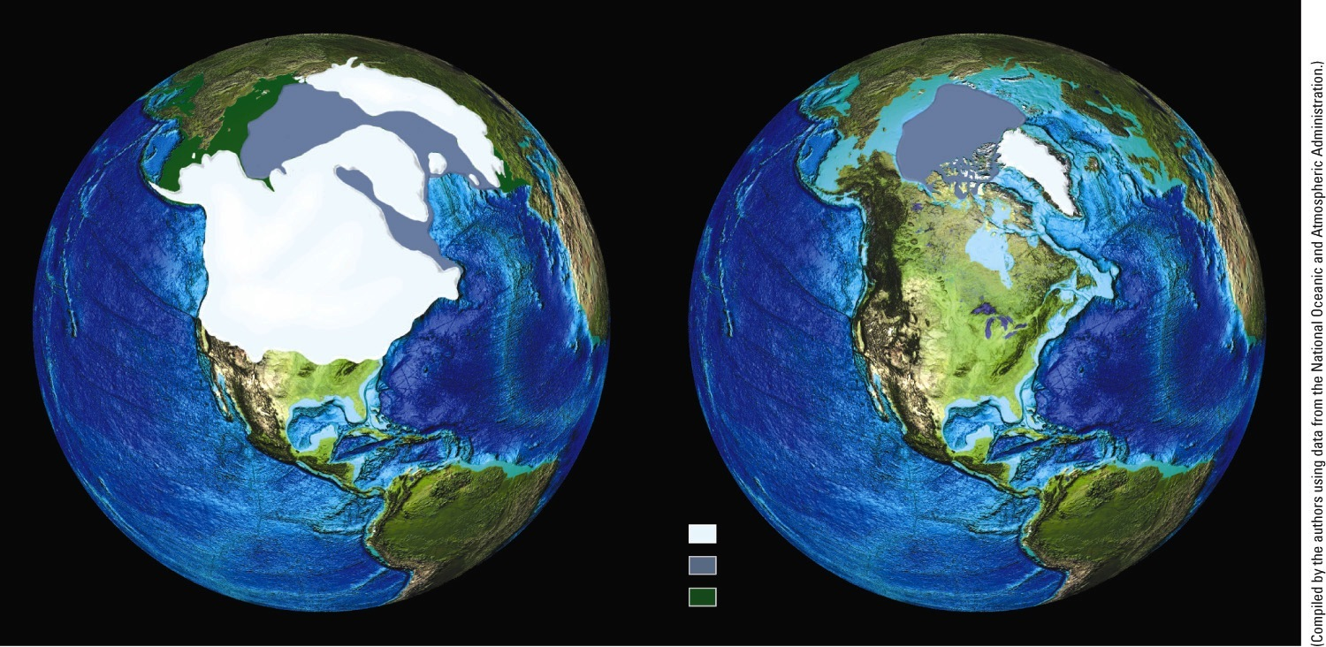
Changes in Ice Coverage in the Northern Hemisphere During the last 18,000 Years
18,000 years before present
Northern Hemisphere Ice coverage
Modern day
(August)
Legend
Continental ice
Sea ice
Land above sea level
Fig. 4-10, p. 87
Notes:
Figure 4-10: These maps of North America show the large-scale changes in glacial ice coverage during the past 18,000 years. Question: What are two characteristics of an animal and two characteristics of a plant that natural selection would have favored as these ice sheets (left) advanced?

Slide 25
4-4 How Do Speciation, Extinction, and Human Activities Affect Biodiversity?
As environmental conditions change, the balance between formation of new species and extinction of existing species determines the earth’s biodiversity
Human activities can decrease biodiversity:
By causing the extinction of many species
By destroying or degrading habitats needed for the development of new species

Slide 26
How Do New Species Evolve?
Speciation – one species splits into two or more species
Geographic isolation
First step
Physical isolation of populations for a long period

Slide 27
How Do New Species Evolve? (cont’d.)
Reproductive isolation
Mutations and natural selection in geographically isolated populations
Leads to inability to produce viable offspring when members of two different populations mate

Slide 28
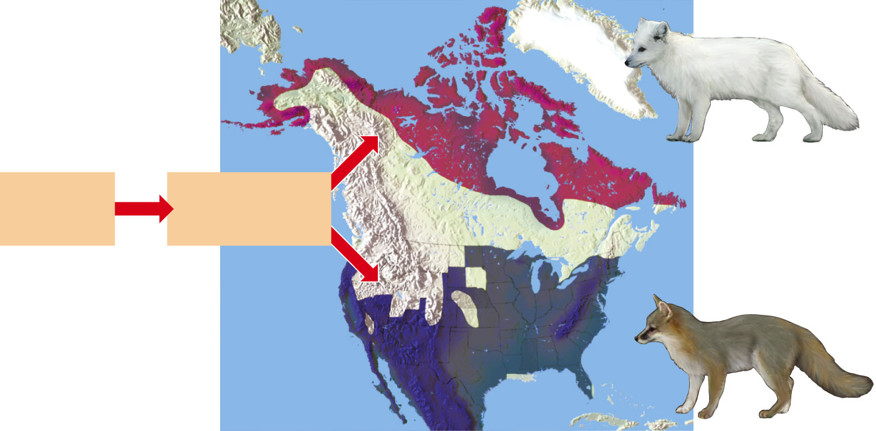
Geographic Isolation Can Lead to Reproductive Isolation
Adapted to cold through heavier fur, short ears, short legs, and short nose. White fur matches snow for camouflage.
Arctic Fox
Northern population
Different environmental conditions lead to different selective pressures and evolution into two different species.
Early fox population
Spreads northward and southward and separates
Gray Fox
Southern population
Adapted to heat through lightweight fur and long ears, legs, and nose, which give off more heat.
Fig. 4-12, p. 88
Notes:
Figure 4.12 Geographic isolation can lead to reproductive isolation, divergence of gene pools, and speciation.

Slide 29
All Species Eventually Become Extinct
Extinction
Process in which an entire species ceases to exist
Endemic species
Found only in one area
Particularly vulnerable to extinction

Slide 30
All Species Eventually Become Extinct
Background extinction
Typical low rate of extinction
Mass extinction
Significant rise above background level

Slide 31
Golden Toad of Costa Rica, Extinct
Fig. 4-13, p. 90
Notes:
Figure 4-13: This male golden toad lived in Costa Rica’s high-altitude Monteverde Cloud Forest Reserve. The species became extinct in 1989 apparently because its habitat dried up.

Slide 32
4-5 What Is Species Diversity and Why Is It Important?
Species diversity is a major component of biodiversity and tends to increase the sustainability of ecosystems

Slide 33
Species Diversity Includes Variety and Abundance
Species diversity
Number and variety of species in a given area
Species richness
The number of different species in a given area
Species evenness
Comparative number of individuals of each species present

Slide 34
Species Diversity Includes Variety and Abundance (cont’d.)
Diversity varies with geographical location
The most species-rich communities
Tropical rain forests
Coral reefs
Ocean bottom zone
Large tropical lakes

Slide 35
Variations in Species Richness and Species Evenness
Fig. 4-14, p. 91
Notes:
Figure 4-14: This area of natural temperate rain forest in Washington’s Olympic National Park (left) has a much higher number of species (higher species richness) and higher species evenness than this tree farm planted in Oregon (right) has.

Slide 36
Species-Rich Ecosystems Tend to Be Productive and Sustainable
Species richness
Increases productivity and stability or sustainability
Provides insurance against catastrophe
How much species richness do you think is needed?

Slide 37
4-6 What Roles Do Species Play in an Ecosystem?
Each species plays a specific ecological role called its niche
Any given species may play one or more of five important roles—native, nonnative, indicator, keystone, or foundation—in a particular ecosystem

Slide 38
Each Species Plays a Role in Its Ecosystem
Ecological niche
Everything that affects survival and reproduction
Water, space, sunlight, food, temperatures
Generalist species
Broad niche – wide range of tolerance
Specialist species
Narrow niche – narrow range of tolerance

Slide 39
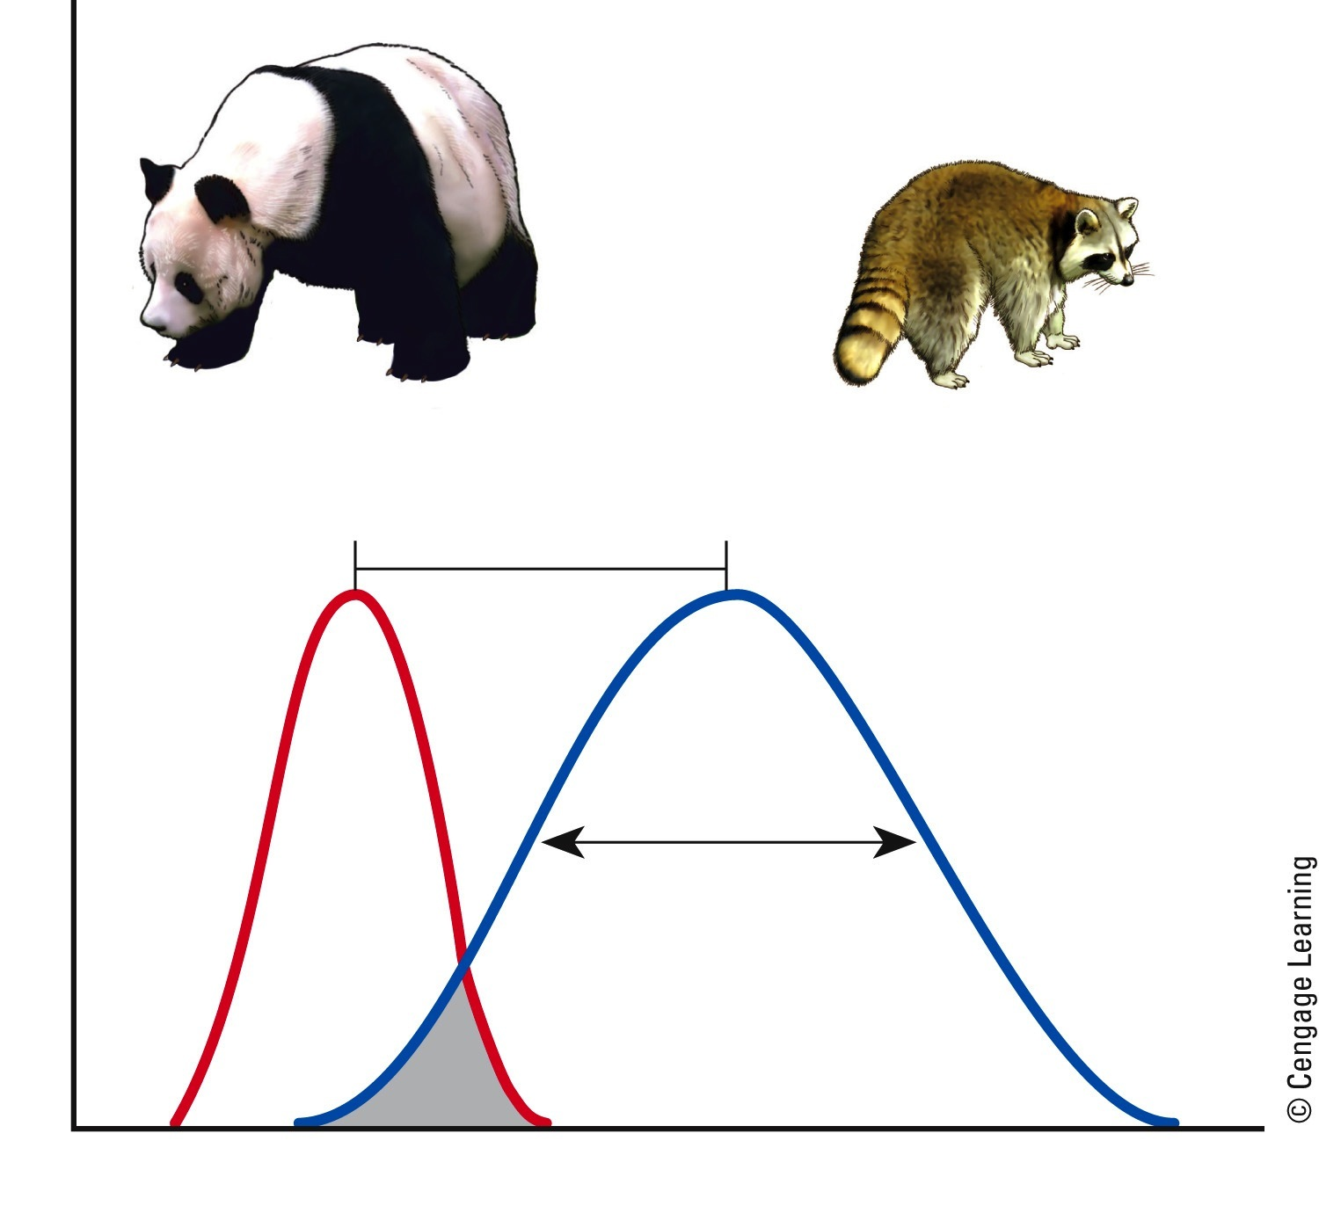
Specialist Species and Generalist Species Niches
Specialist species with a narrow niche
Generalist species with a broad niche
Niche separation
Number of individuals
Niche breadth
Region of
niche overlap
Resource use
Fig. 4-15, p. 92
Notes:
Figure 4.15 Specialist species such as the giant panda have a narrow niche (left curve) and generalist species such as the raccoon have a broad niche (right curve).

Slide 40
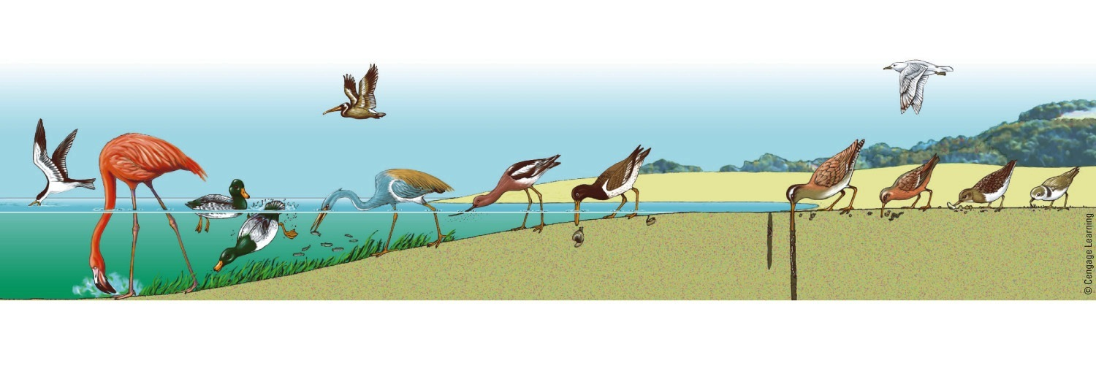
Specialized Feeding Niches of Various Bird Species in a Coastal Wetland
Herring gull is a tireless scavenger
Brown pelican dives for fish, which it locates from the air
Ruddy turnstone searches under shells and pebbles for small invertebrates
Avocet sweeps bill through mud and surface water in search of small crustaceans, insects, and seeds
Black skimmer seizes small fish at water surface
Dowitcher probes deeply into mud in search of snails, marine worms, and small crustaceans
Flamingo feeds on minute organisms
in mud
Scaup and other diving ducks feed on mollusks, crustaceans, and aquatic vegetation
Louisiana heron wades into water to seize small fish
Oystercatcher feeds on clams, mussels, and other shellfish into which it pries
its narrow beak
Knot (sandpiper) picks up worms and small crustaceans left by receding tide
Piping plover feeds on insects and tiny crustaceans on sandy beaches
Fig. 4-16, p. 92
Notes:
Figure 4.16 Various bird species in a coastal wetland occupy specialized feeding niches. This specialization reduces competition and allows for sharing of limited resources.

Slide 41
Case Study: The Giant Panda – A Highly Endangered Specialist
1600 to 3000 Pandas left in the wild
Pandas need bamboo
Makes it a specialist species
Habitat is currently being destroyed
Low reproductive rate
Females give birth to 1 or 2 cubs every 2-3 years

Slide 42
Species Can Play Four Major Roles within Ecosystems
Native species
Normally live in an ecosystem
Nonnative species
Not native
Indicator species
Keystone species

Slide 43
Indicator Species Serve as Biological Smoke Alarms
Indicator species
Provide early warning of damage to a community
Can monitor environmental quality

Slide 44
Keystone Species Play Critical Roles in Their Ecosystems
Keystone species
Have a large effect on the types and abundances of other species
Can play critical roles in helping sustain ecosystems
Pollination
Top predators

Slide 45
Case Study: A Keystone Species That Almost Went Extinct
The American alligator:
Largest reptile in North America, keystone species in its ecosystems
1930s – Hunted and poached
1967 – added to the endangered species list
1977 – impressive comeback
More than a million alligators today in Florida

Slide 46
The American Alligator
Fig. 4-19, p. 95
Notes:
Figure 4-19: Keystone species: The American alligator plays an important ecological role in its marsh and swamp habitats in the southeastern United States.

Slide 47
Three Big Ideas
Populations evolve through mutations in genes
Certain genetic traits enhance individuals ability to produce offspring with these traits

Slide 48
Three Big Ideas (cont’d.)
Human activities are degrading biodiversity
Hastening the extinction of species
Disrupting habitats needed for development of new species

Slide 49
Three Big Ideas (cont’d.)
Each species plays a specific ecological role (its ecological niche) in the ecosystem where it is found

Slide 50
Tying It All Together – Amphibians and Sustainability
Importance of a species does not always match the public’s perception of it
Extinction of species may lead to further extinctions
Biodiversity and evolution
Vital forms of natural capital
Ecosystems help sustain biodiversity

