Slide 1
3
Ecosystems: What Are They and How Do They Work?

Slide 2
Core Case Study: Tropical Rain Forests Are Disappearing
Cover only about 2% of the earth’s land surface
Contain about 50% of the world’s known plant and animal species
Major harmful effects of disruption
Reduces biodiversity
Accelerates global warming
Changes regional weather patterns

Slide 3
Natural Capital Degradation: The Lost of Tropical Rain Forest
Fig. 3-1, p. 52
Notes:
Figure 3-1: Natural capital degradation. Satellite image of the loss of tropical rain forest, cleared for farming, cattle grazing, and settlements, near the Bolivian city of Santa Cruz between June 1975 (left) and May 2003 (right).

Slide 4
3-1 How Does the Earth’s Life-Support System Work?
The four major components of the earth’s life-support system
The atmosphere (air), the hydrosphere (water), the geosphere (rock, soil, and sediment), and the biosphere (living things)
Life is sustained by the flow of energy from the sun through the biosphere, the cycling of nutrients within the biosphere, and gravity

Slide 5
The Earth’s Life-Support System Has Four Major Components
Atmosphere
Troposphere: where weather happens
Stratosphere: contains ozone layer
Hydrosphere: water on the earth’s surface
Geosphere: the solid earth
Biosphere: life

Slide 6
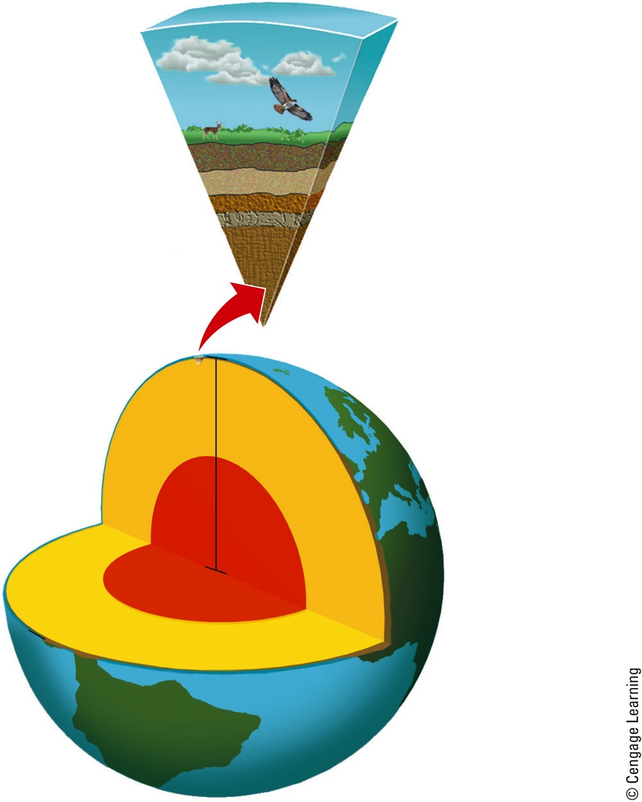
Natural Capital: General Structure of the Earth
Atmosphere
Biosphere
(living organisms)
Soil
Rock
Crust
Mantle
Geosphere
(crust, mantle, core)
Mantle
Core
Atmosphere (air)
Hydrosphere (water)
Fig. 3-2, p. 53
Notes:
Figure 3.2 Natural capital: The earth consists of a land sphere (geosphere), an air sphere (atmosphere), a water sphere (hydrosphere), and a life sphere (biosphere) (Concept 3-1A).

Slide 7
Three Factors Sustain Life on Earth
One-way flow of high-quality energy:
Sun → plants → living things → environment as heat → radiation to space
Cycling of nutrients through parts of the biosphere
Gravity holds the earth’s atmosphere

Slide 8
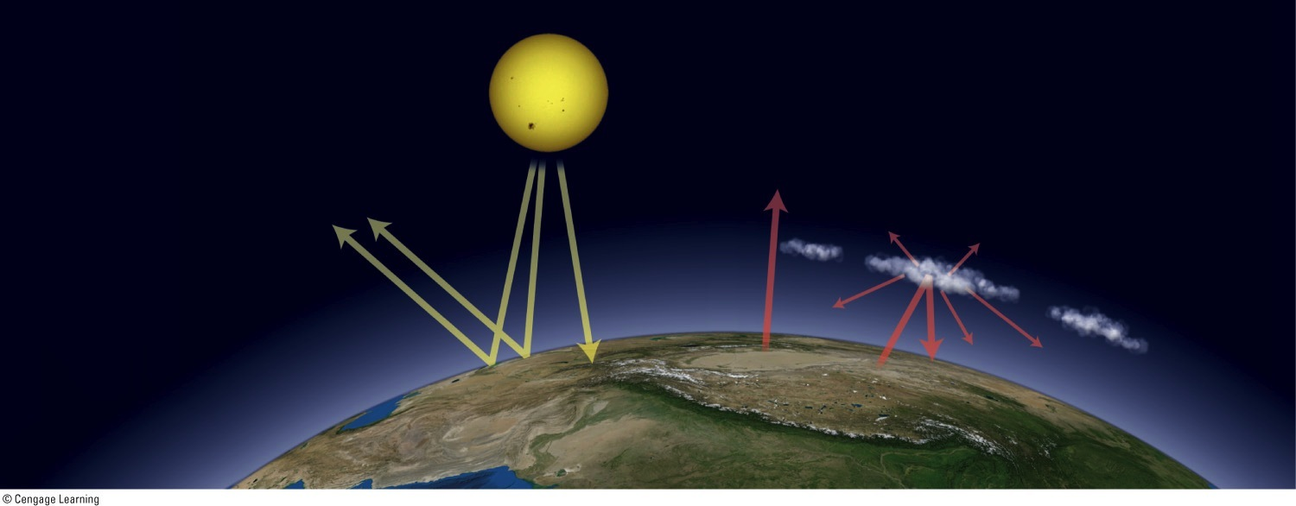
Greenhouse Earth
1. The solar energy that powers the earth’s climate system is short-wave radiation.
2. Roughly half of the incoming solar radiation
is absorbed
by the earth’s surface.
4. The solar radiation absorbed by the earth’s surface is converted to heat and emitted as long-wave radiation.
SUN
3. Some of the incoming solar radiation is reflected by the earth’s surface and atmosphere back out to space.
5. Some of the infrared radiation escapes into space, but most of it is absorbed by greenhouse gases and clouds in the earth’s atmosphere, and this interaction between gases and radiation warms the earth’s lower atmosphere and surface.
ATMOSPHERE
EARTH
Fig. 3-3, p. 54
Notes:
Figure 3-3: Greenhouse Earth. High-quality solar energy flows from the sun to the earth. It is degraded to lower-quality energy (mostly heat) as it interacts with the earth’s air, water, soil, and life-forms, and eventually returns to space. Certain gases in the earth’s atmosphere retain enough of the sun’s incoming energy as heat to warm the planet in what is known as the greenhouse effect.

Slide 9
3-2 What Are the Major Components of an Ecosystem?
Some organisms produce the nutrients they need
Others get their nutrients by consuming other organisms
Some recycle nutrients back to producers by decomposing the wastes and remains of organisms

Slide 10
Ecosystems Have Several Important Components
Ecology
Science of organism’s interactions with each other and their nonliving environment
Ecologists study interactions within and among:
Organisms
Populations
Communities
Ecosystems
Biosphere

Slide 11
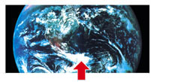
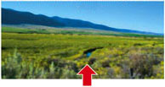
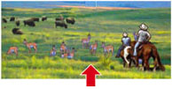
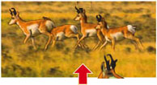
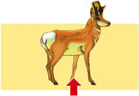
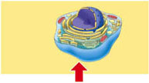
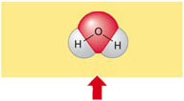
Biosphere
Parts of the earth's air, water, and soil where life is found
Ecosystem
A community of different species interacting with one another and with their nonliving environment of matter and energy
Community
Populations of different species living in a particular place, and potentially interacting with each other
Population
A group of individuals of the same species living in a particular place
Organism
An individual living being
The fundamental structural and functional unit of life
Cell
Molecule
Chemical combination of two or more atoms of the same or different elements
Water
Atom
Smallest unit of a chemical element that exhibits its chemical properties
Hydrogen
Oxygen
Stepped Art
Fig. 3-4 p. 55

Slide 12
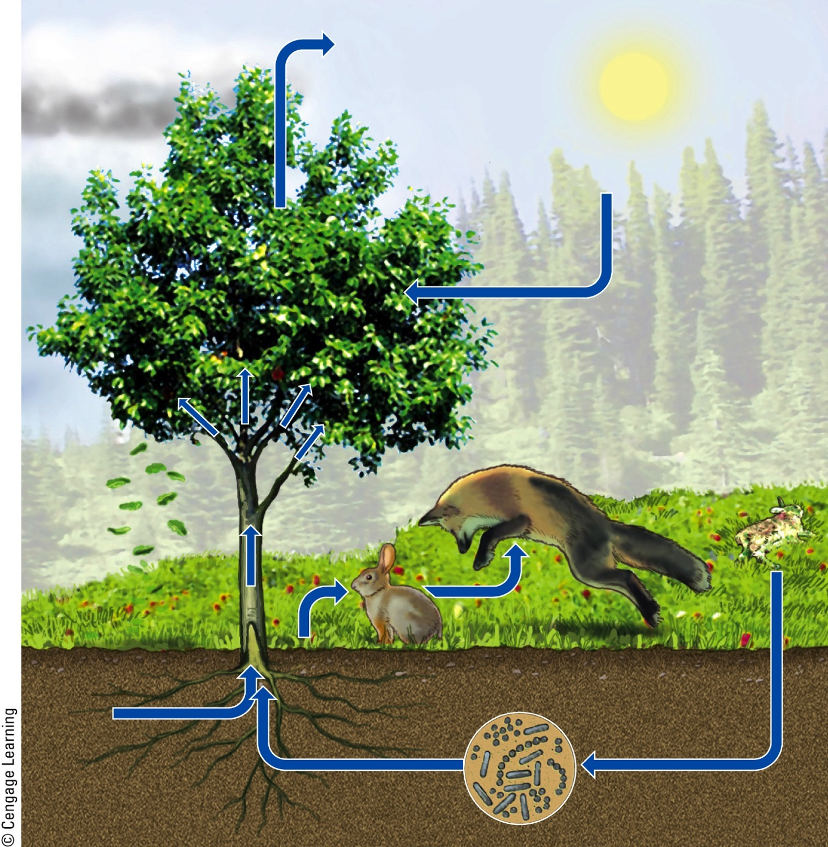
Major Biotic and Abiotic Components of an Ecosystem
Oxygen (O₂)
Precipitaton
Carbon dioxide (CO₂)
Producer
Secondary consumer (fox)
Primary consumer (rabbit)
Producers
Water
Decomposers
Soluble mineral nutrients
Fig. 3-5, p. 56
Notes:
Animated Figure 3.5 key living and nonliving components of an ecosystem in a field.

Slide 13
Ecosystems Have Several Important Components (cont’d.)
Producers (autotrophs)
Photosynthesis
CO₂ + H₂O + sunlight → glucose + oxygen
Consumers (heterotrophs)
Primary consumers = herbivores
Secondary consumers
Tertiary consumers
Carnivores, omnivores

Slide 14
Producers
Fig. 3-6, p. 56
Notes:
Figure 3-6: Some producers such as trees and other plants (left) live on land. Others such as green algae (right) live in water.

Slide 15
Consumers
Fig. 3-7, p. 57
Notes:
Figure 3-7: This lioness (a carnivore) is feeding on a freshly killed zebra (an herbivore) in Kenya, Africa.

Slide 16
Ecosystems Have Several Important Components
Decomposers
Consumers that release nutrients
Detritivores
Feed on dead bodies of other organisms
There is very little waste of nutrients in nature

Slide 17
Decomposer
Fig. 3-8, p. 57
Notes:
Figure 3-8: These sulfur tuft fungi feeding on a tree stump (left) are decomposers. The vultures and Marabou storks (above), eating the carcass of an animal that was killed by another animal, are detritivores.

Slide 18
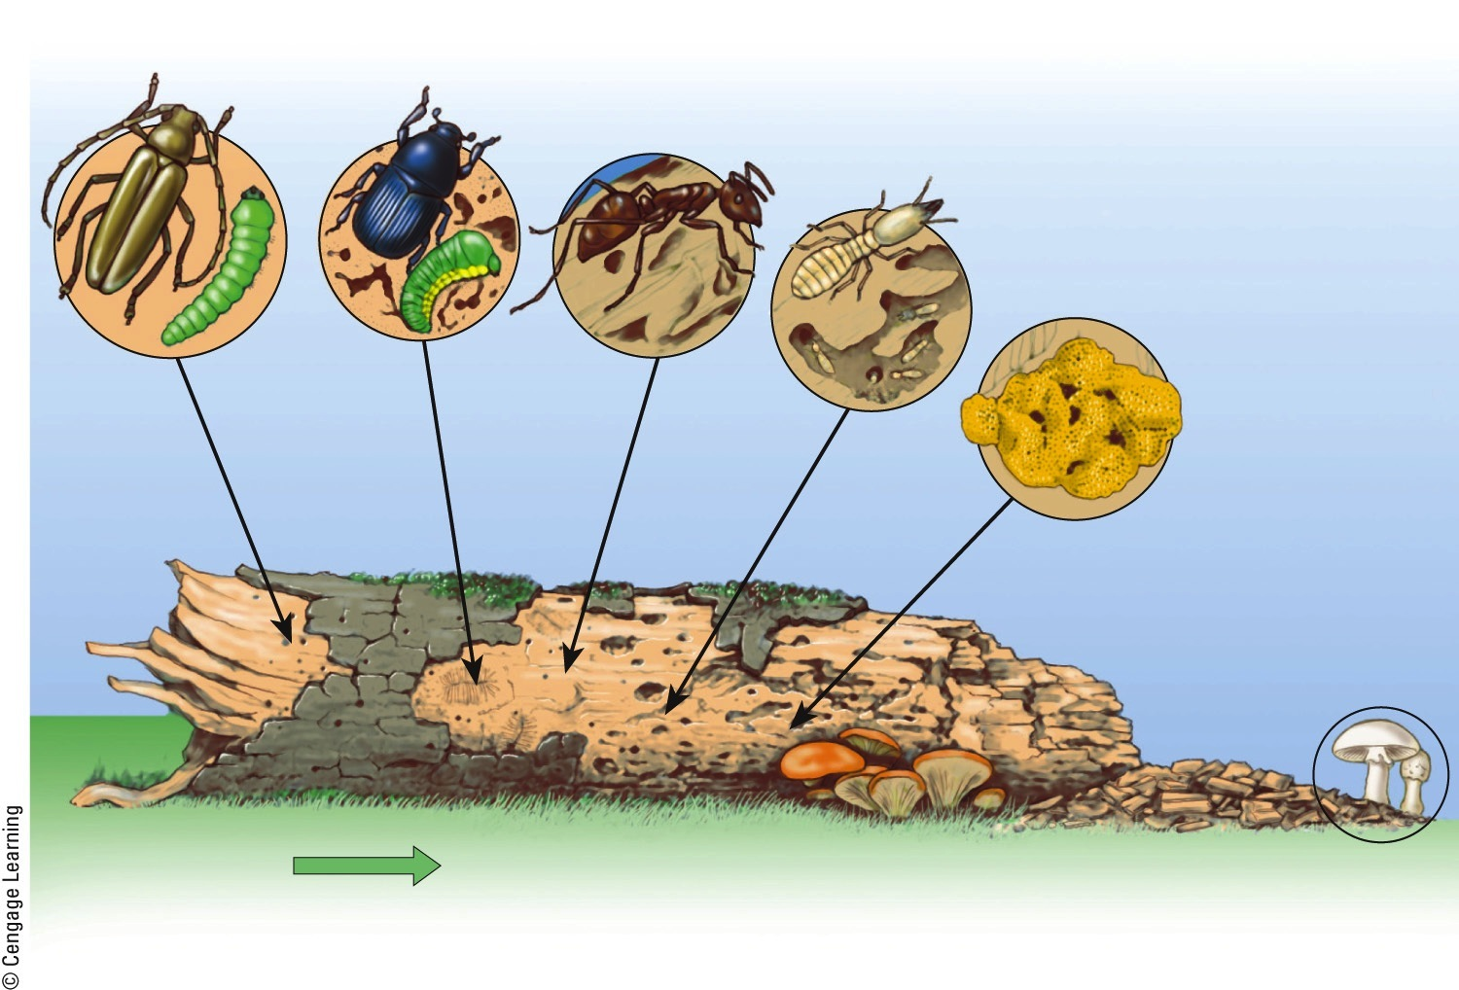
Detritivores and Decomposers
Detritus feeders
Decomposers
Bark beetle engraving
Carpenter
ant galleries
Termite and carpenter ant work
Long-horned beetle holes
Dry rot
fungus
Wood reduced
to powder
Mushroom
Time progression
Powder broken down by decomposers into plant nutrients in soil
Fig. 3-9, p. 58
Notes:
Figure 3.9 Various detritivores and decomposers (mostly fungi and bacteria) can “feed on” or digest parts of a log and eventually convert its complex organic chemicals into simpler inorganic nutrients that can be taken up by producers.

Slide 19
Organisms Get Their Energy in Different Ways
Aerobic respiration
Using oxygen to turn glucose back to carbon dioxide and water
Anaerobic respiration
Fermentation
End products are carbon compounds such as methane or acetic acid

Slide 20
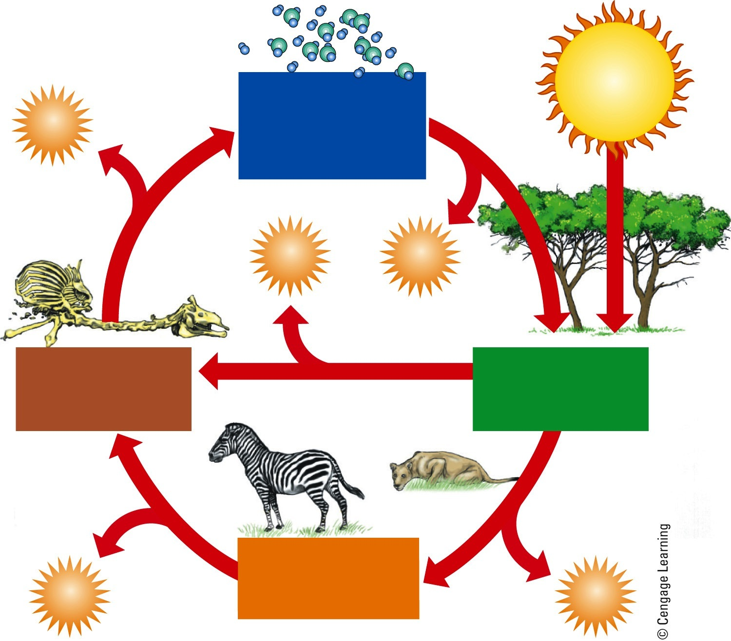
The Components of an Ecosystem
Solar energy
Chemical nutrients (carbon dioxide, oxygen, nitrogen, minerals)
Heat
Heat
Heat
Decomposers (bacteria, fungi)
Producers (plants)
Consumers (plant eaters, meat eaters)
Heat
Heat
Fig. 3-10, p. 59
Notes:
Animated Figure 3.10 Natural capital: The main components of an ecosystem are energy, chemicals, and organisms. nutrient cycling and the flow of energy—first from the sun, then through organisms, and finally into the environment as low-quality heat—link these components

Slide 21
3-3 What Happens to Energy in an Ecosystem?
As energy flows through ecosystems in food chains and webs, the amount of chemical energy available to organisms at each successive feeding level decreases

Slide 22
Energy Flows Through Ecosystems in Food Chains and Food Webs
Food chain
Movement of energy and nutrients from one trophic level to the next
Photosynthesis → feeding → decomposition
Food web
Network of interconnected food chains

Slide 23
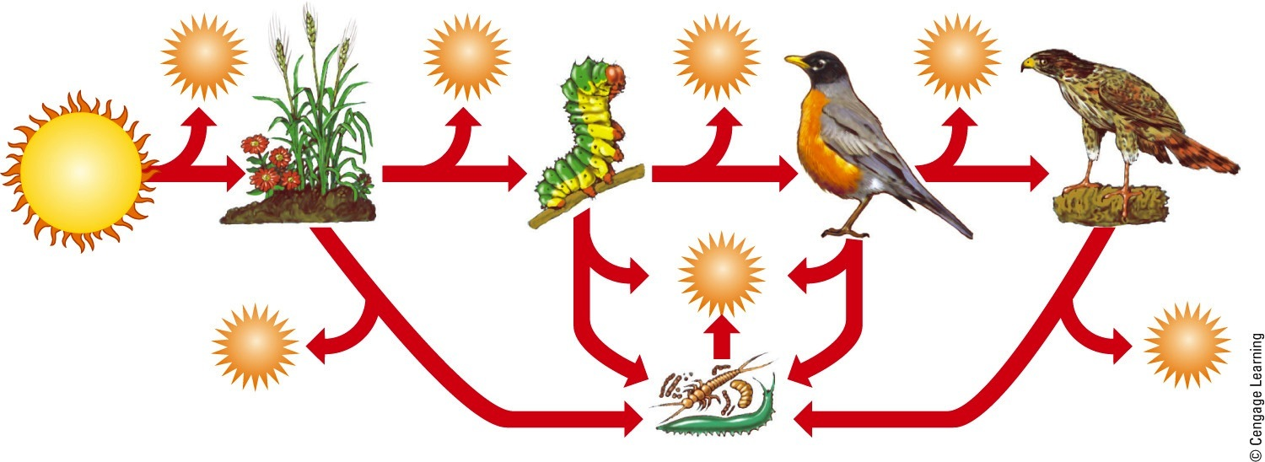
A Food Chain
First Trophic Level
Second Trophic Level
Third Trophic Level
Fourth Trophic Level
Producers (plants)
Primary consumers (herbivores)
Secondary consumers (carnivores)
Tertiary consumers
(top carnivores)
Heat
Heat
Heat
Heat
Solar energy
Heat
Heat
Heat
Decomposers and detritus feeders
Fig. 3-11, p. 60
Notes:
Figure 3-11: In a food chain, chemical energy in nutrients flows through various trophic levels. Question: Think about what you ate for breakfast. At what level or levels on a food chain were you eating?

Slide 24
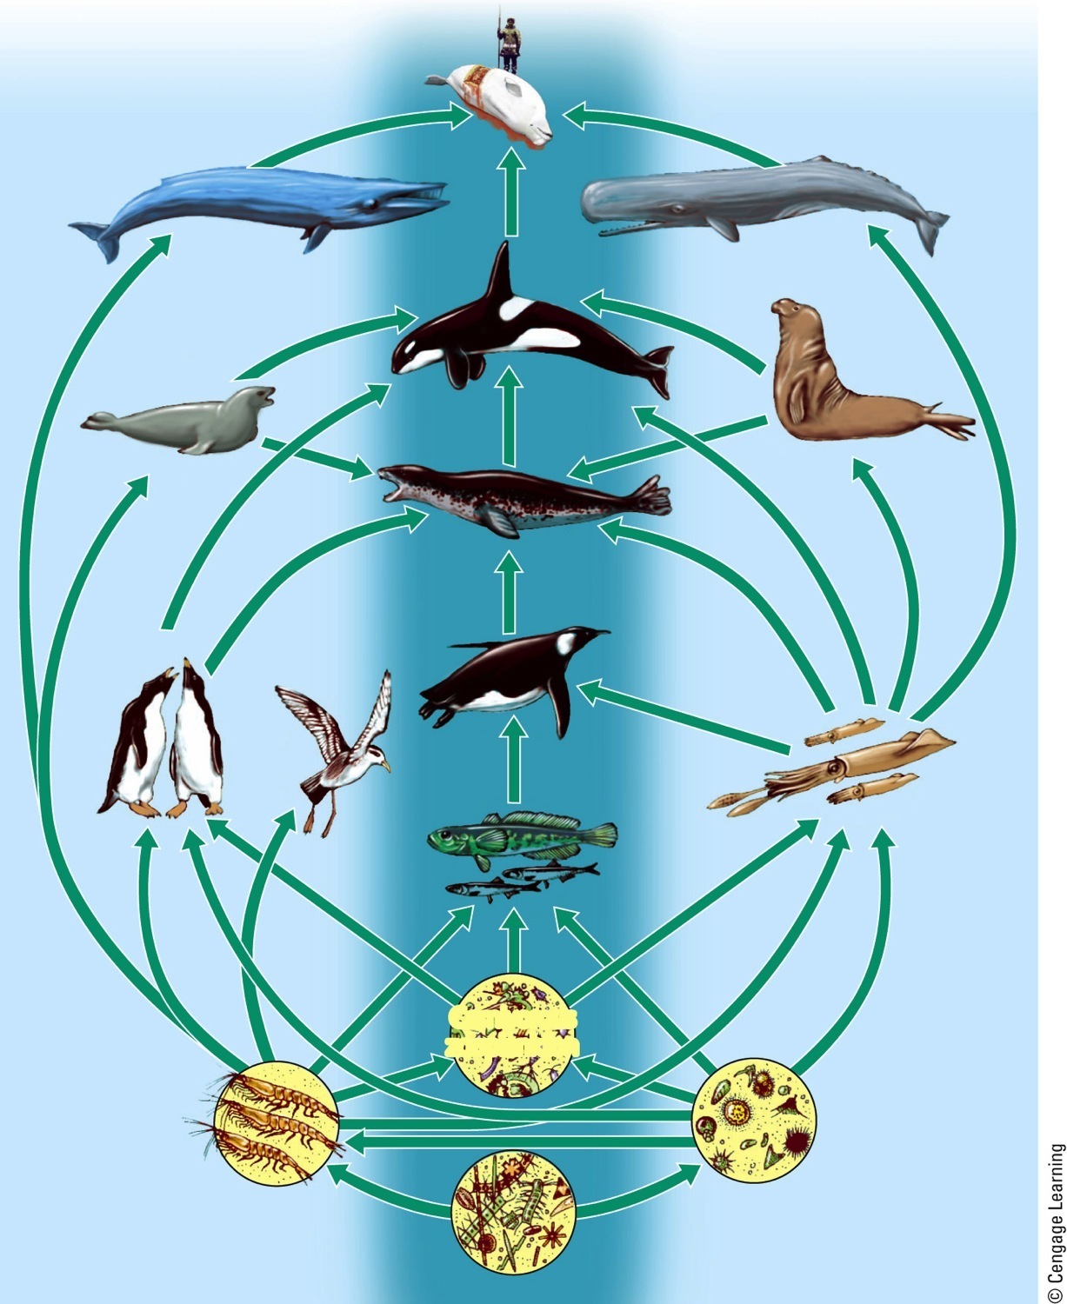
A Food Web
Humans
Blue whale
Sperm whale
Elephant seal
Crabeater seal
Killer whale
Adelie penguin
Leopard seal
Emperor penguin
Petrel
Squid
Fish
Carnivorous zooplankton
Herbivorous zooplankton
Krill
Phytoplankton
Fig. 3-12, p. 60
Notes:
Figure 3-12: This is a greatly simplified food web found in the southern hemisphere. The shaded middle area shows a simple food chain that is part of these complex interacting feeding relationships. Many more participants in the web, including an array of decomposer and detritus feeder organisms, are not shown here. Question: Can you imagine a food web of which you are a part? Try drawing a simple diagram of it.

Slide 25
Usable Energy Decreases with Each Link in a Food Chain or Web
Biomass
Dry weight of all organic matter of a given trophic level in a food chain or food web
Decreases at each higher trophic level due to heat loss
Pyramid of energy flow
90% of energy lost with each transfer
Less chemical energy for higher trophic levels

Slide 26
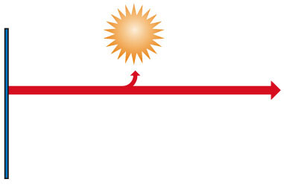
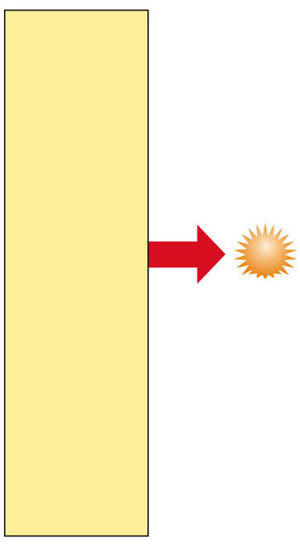
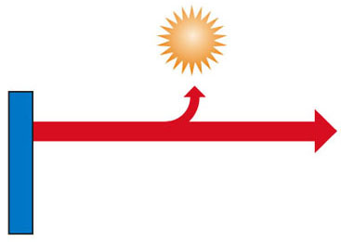
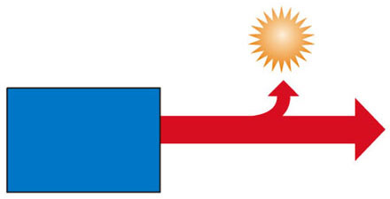
Usable energy available
at each trophic level
(in kilocalories)
Heat
Tertiary
consumers
(human)
10
Heat
Secondary
consumers
(perch)
100
Heat
Decomposers
Heat
Primary
consumers
(zooplankton)
1,000
Heat
10,000
Producers
(phytoplankton)
Stepped Art
Fig. 3-13, p. 61
Notes:
Animated Figure 3.13 This model is a generalized pyramid of energy flow that shows the decrease in usable chemical energy available at each succeeding trophic level in a food chain or web. The model assumes that with each transfer from one trophic level to another, there is a 90% loss of usable energy to the environment in the form of low-quality heat. Heat Calories and joules are used to measure energy. 1 kilocalorie 5 1,000 calories 5 4,184 joules. Question: Why is a vegetarian diet more energy efficient than a meat-based diet?

Slide 27
Some Ecosystems Produce Plant Matter Faster Than Others Do
Gross primary productivity (GPP)
Rate at which an ecosystem’s producers convert solar energy to chemical energy and biomass
Kcal/m²/year

Slide 28
Some Ecosystems Produce Plant Matter Faster Than Others Do (cont’d.)
Net primary productivity (NPP)
Rate at which an ecosystem’s producers convert solar energy to chemical energy, minus the rate at which producers use energy for aerobic respiration
Ecosystems and life zones differ in their NPP

Slide 29
Estimated Annual Average NPP in Major Life Zones and Ecosystems
Fig. 3-14, p. 62
Notes:
Figure 3-14: The estimated annual average net primary productivity in major life zones and ecosystems is expressed in this graph as kilocalories of energy produced per square meter per year (kcal/m²/yr). Question: What are the three most productive and the three least productive systems?

Slide 30
3-4 What Happens to Matter in an Ecosystem?
Matter, in the form of nutrients, cycles within and among ecosystems and the biosphere, and human activities are altering these chemical cycles

Slide 31
Nutrients Cycle within and among Ecosystems
Nutrient cycles
Hydrologic
Carbon
Nitrogen
Phosphorus
Sulfur
Nutrients may remain in a reservoir for a period of time

Slide 32
The Water Cycle
Three major processes
Evaporation, precipitation, transpiration
Alteration of the hydrologic cycle by humans
Withdrawal of large amounts of freshwater at rates faster than nature can replace it
Clearing vegetation
Increased flooding when wetlands are drained

Slide 33
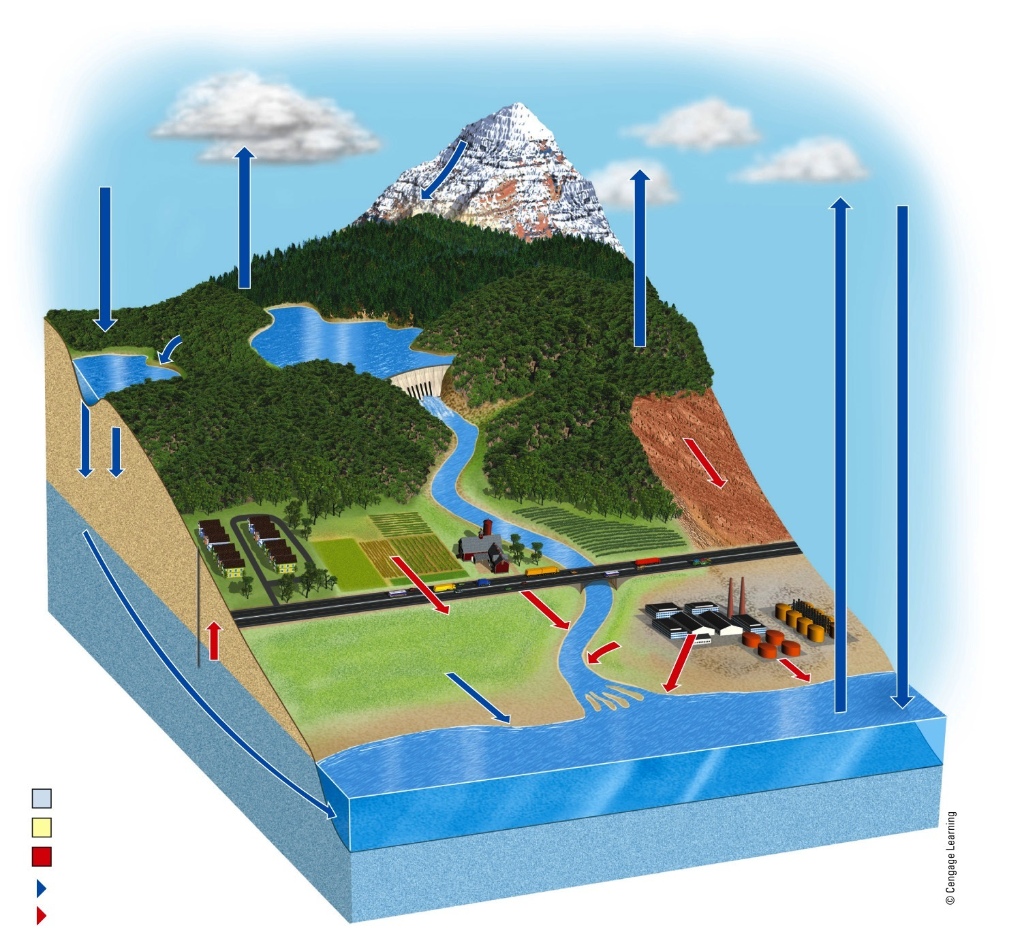
Condensation
Ice and snow
Condensation
Transpiration
from plants
Precipitation to land
Evaporation of
surface water
Runoff
Evaporation
from ocean
Lakes and
reservoirs
Runoff
Precipitation to ocean
Increased runoff on land covered with crops, buildings and pavement
Infiltration and percolation into aquifer
Increased runoff from cutting forests and filling wetlands
Runoff
Groundwater in aquifers
Overpumping of aquifers
Water pollution
Runoff
Ocean
Natural process
Natural reservoir
Human impacts
Natural pathway
Pathway affected by human activities
Fig. 3-15, p. 63
Notes:
Animated Figure 3.15 Natural capital: This is a simplified model of the water cycle, or hydrologic cycle, in which water circulates in various physical forms within the biosphere. The red arrows and boxes identify major effects of human activities on this cycle. Question: What are three ways in which your lifestyle directly or indirectly affects the hydrologic cycle?

Slide 34
Science Focus: Water’s Unique Properties
Properties of water due to hydrogen bonds between water molecules:
Liquid over large temperature range
Changes temperature slowly
High boiling point: 100˚C
Adhesion and cohesion
Expands as it freezes
Solvent
Filters out harmful UV

Slide 35
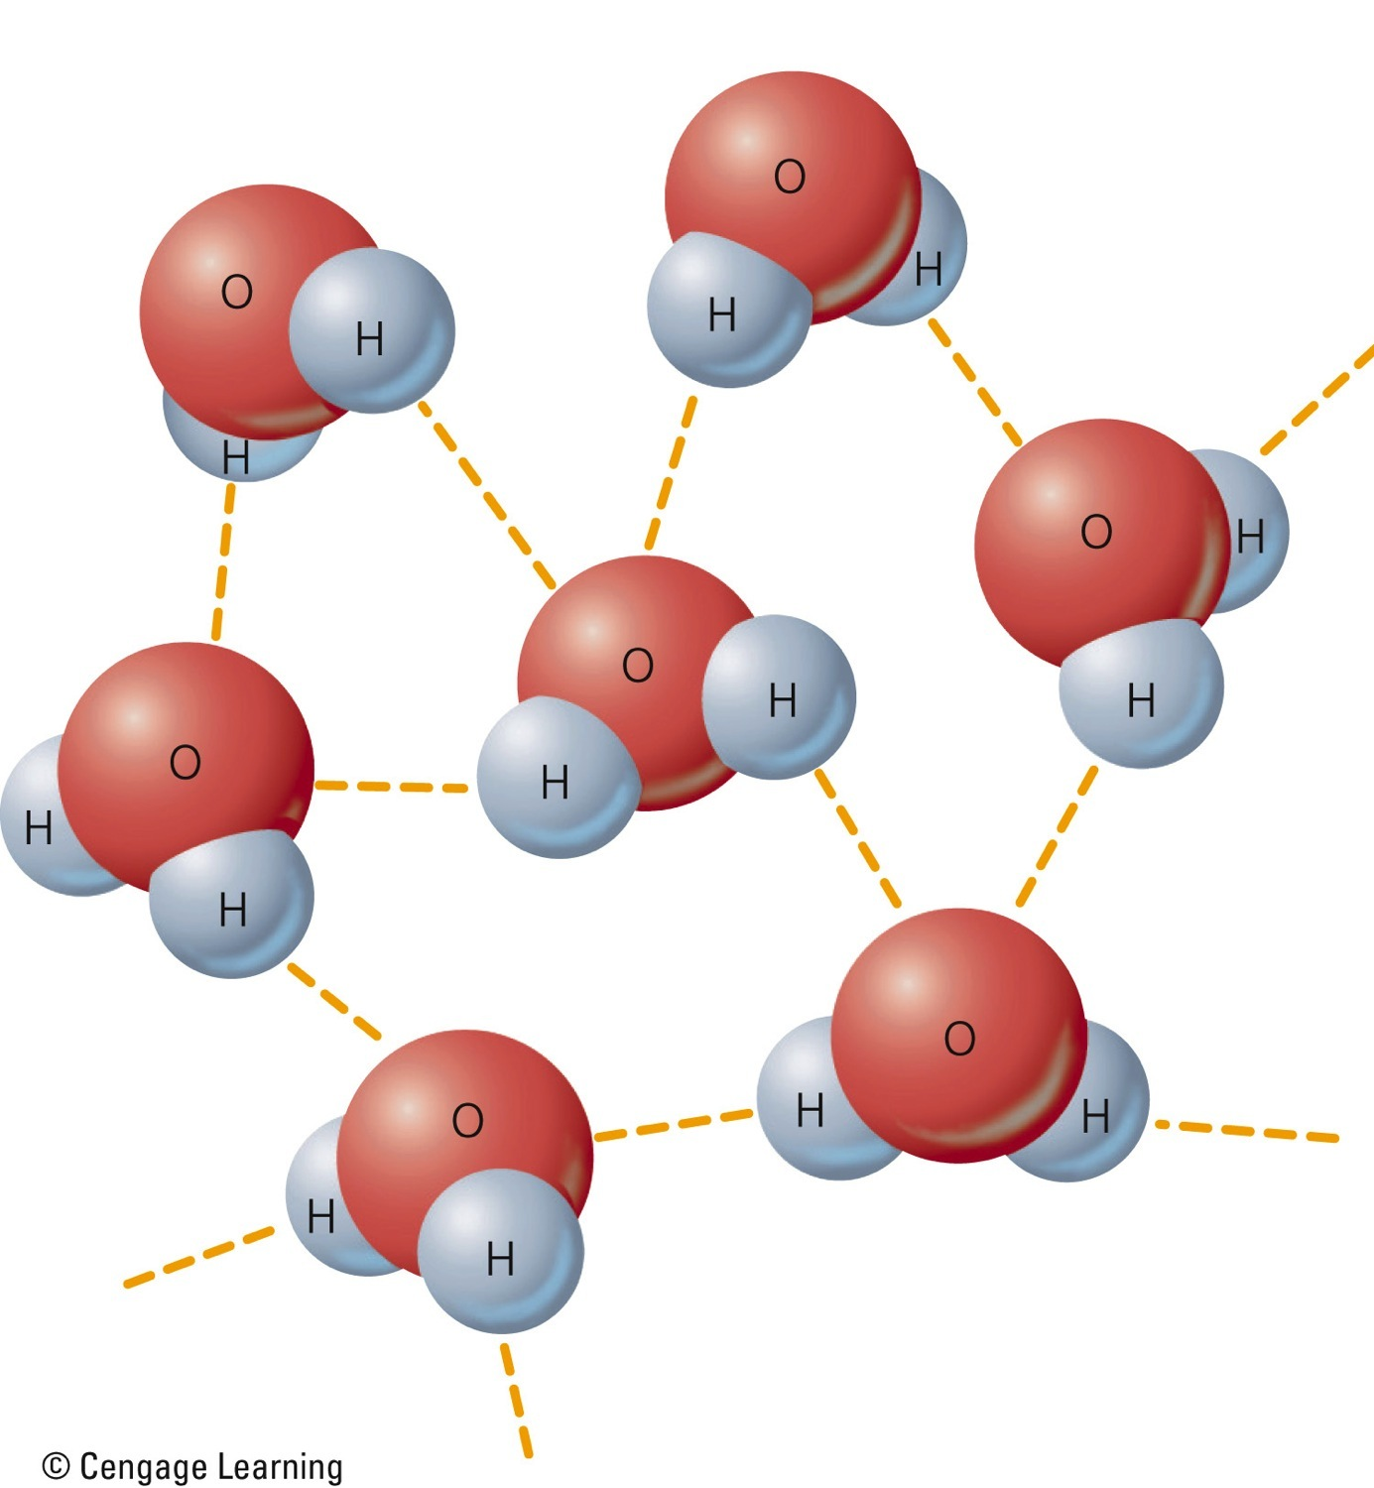
Slightly negative charge
Hydrogen Bonds in Water
Hydrogen
bonds
Slightly positive charge
Fig. 3-A, p. 64
Notes:
Figure 3.A Hydrogen bond: Because of the slightly unequal sharing of electrons in an H2O molecule, its oxygen atoms hold a slightly negative charge and its hydrogen atoms hold a slightly positive charge. Since opposite electrical charges attract one another, the hydrogen atoms of one water molecule are attracted to the oxygen atoms in other water molecules. These fairly weak forces of attraction between molecules (represented by the dashed lines) are called hydrogen bonds.

Slide 36
The Carbon Cycle
Based on CO₂
Producers remove CO₂ from the atmosphere
Consumers use CO₂
Some carbon takes a long time to recycle
Humans altering carbon cycle by burning fossil fuels

Slide 37
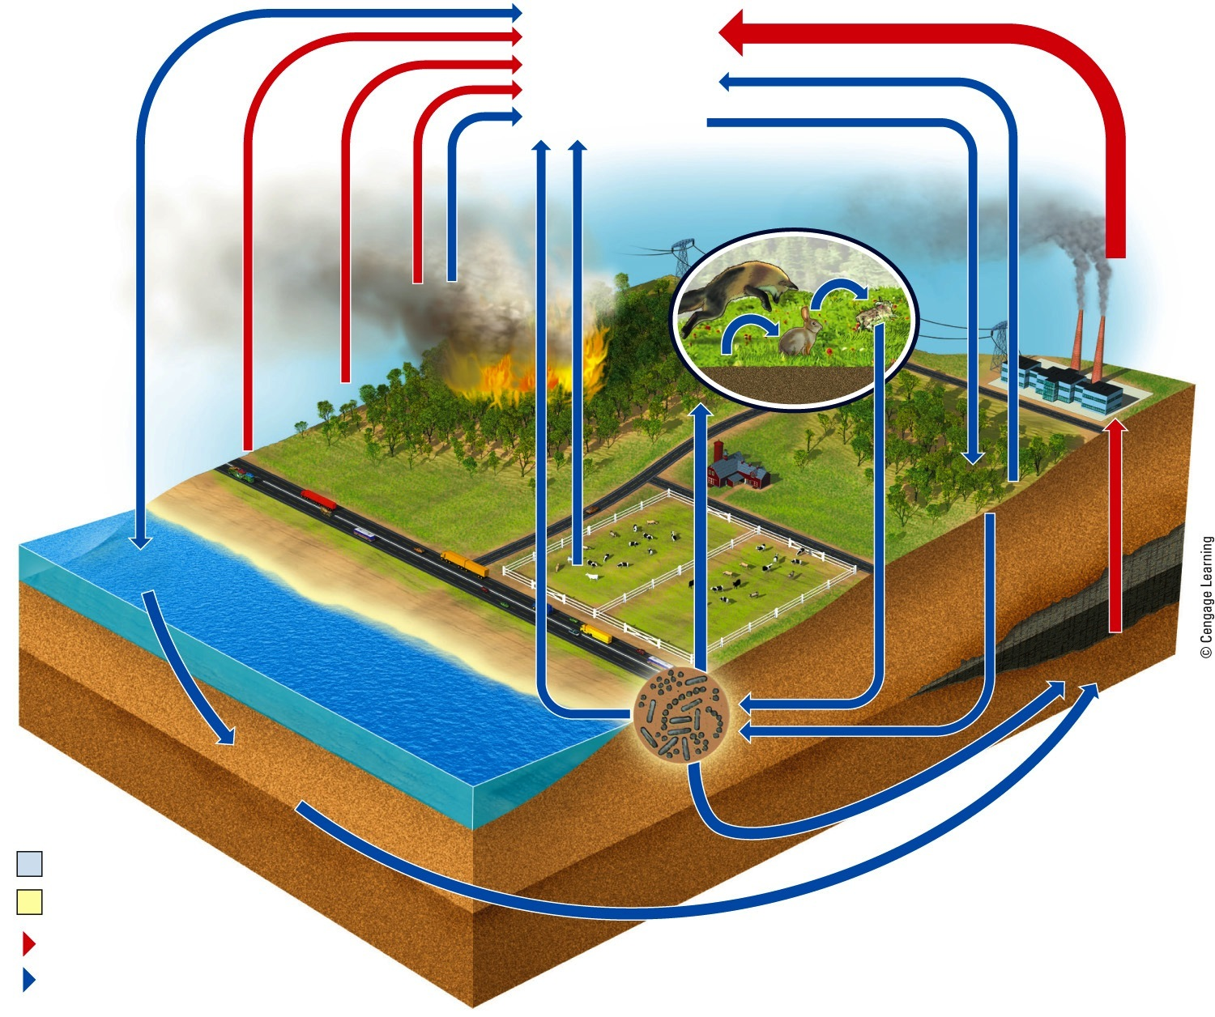
Carbon dioxide in atmosphere
Respiration
Photosynthesis
Animals (consumers)
Burning fossil fuels
Diffusion
Forest fires
Plants (producers)
Deforestation
Transportation
Respiration
Carbon in plants (producers)
Carbon dioxide dissolved in ocean
Carbon in animals (consumers)
Marine food webs Producers, consumers, decomposers
Carbon in fossil fuels
Decomposition
Carbon
in limestone or dolomite sediments
Compaction
Process
Reservoir
Pathway affected by humans
Natural pathway
Fig. 3-17, p. 66
Notes:
Animated Figure 3.17 Natural capital: This simplified model illustrates the circulation of various chemical forms of carbon in
the global carbon cycle, with major impacts of human activities shown by the red arrows. (yellow box sizes do not show relative reservoir sizes.) Question: What are three ways in which you directly or indirectly affect the carbon cycle?

Slide 38
The Nitrogen Cycle: Bacteria in Action
Nitrogen fixation
Lightning
Bacteria and cyanobacteria
Combine gaseous nitrogen with hydrogen to make ammonia (NH₃) and ammonium ions (NH₄⁺)
Nitrification
Soil bacteria change ammonia and ammonium ions to nitrate ions (NO₃⁻)

Slide 39
The Nitrogen Cycle: Bacteria in Action (cont’d.)
Denitrification
Nitrate ions back to nitrogen gas
Humans are removing nitrogen from the atmosphere faster than it can be replaced

Slide 40
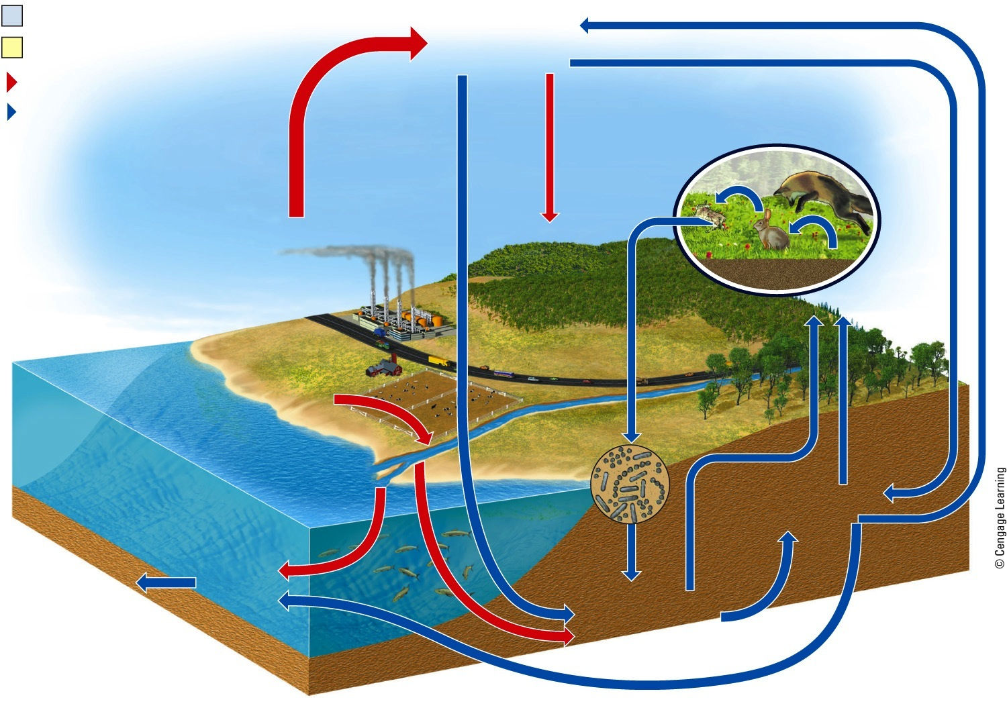
Denitrification by bacteria
Process
Nitrogen
in atmosphere
Reservoir
Nitrification by bacteria
Pathway affected by humans
Natural pathway
Nitrogen in animals (consumers)
Electrical storms
Nitrogen oxides from burning fuel and using inorganic fertilizers
Commercial
nitrogen
fertilizer
Nitrogen
in plants (producers)
Decomposition
Nitrates from fertilizer
runoff and decomposition
Uptake by plants
Nitrate in soil
Nitrogen loss
to deep ocean sediments
Nitrogen
in ocean sediments
Nitrification
by bacteria
Ammonia in soil
Fig. 3-18, p. 67
Notes:
Animated Figure 3.18 Natural capital: This is a simplified model of the circulation of various chemical forms of nitrogen in the global nitrogen cycle, with major human impacts shown by the red arrows. (yellow box sizes do not show relative reservoir sizes.) Question: What are two ways in which the carbon cycle and the nitrogen cycle are linked?

Slide 41
The Phosphorous Cycle
Cycles through water, the earth’s crust, and living organisms
Impact of human activities
Clearing forests
Removing large amounts of phosphate from the earth to make fertilizers
Erosion leaches phosphates into streams

Slide 42
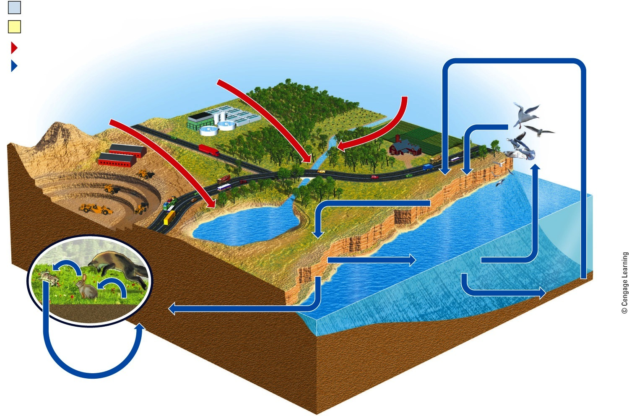
Process
Reservoir
Pathway affected by humans
Natural pathway
Phosphates in sewage
Phosphates in fertilizer
Plate tectonics
Phosphates in mining waste
Runoff
Runoff
Sea birds
Runoff
Phosphate in rock (fossil bones, guano)
Erosion
Ocean food webs
Animals (consumers)
Phosphate dissolved
in water
Phosphate in shallow ocean sediments
Phosphate in deep ocean sediments
Plants (producers)
Bacteria
Fig. 3-19, p. 68
Notes:
Figure 3.19 Natural capital: This is a simplified model of the circulation of various chemical forms of phosphorus (mostly phosphates) in the phosphorus cycle, with major human impacts shown by the red arrows. (yellow box sizes do not show relative reservoir sizes.) Questions: What are two ways in which the phosphorus cycle and the nitrogen cycle are linked? What are two ways in which the phosphorus cycle and the carbon cycle are linked?

Slide 43
Three Big Ideas
Life is sustained by:
The flow of energy from the sun through the biosphere
The cycling of nutrients within the biosphere
Gravity

Slide 44
Three Big Ideas (cont’d.)
Some organisms produce the nutrients they need
Some organisms consume others
Some organisms live on wastes and recycle nutrients

Slide 45
Three Big Ideas (cont’d.)
Human activities are altering:
The flow of energy through food chains and webs
The cycling of nutrients within ecosystems and the biosphere

Slide 46
Tying It All Together: Tropical Rainforests and Sustainability
Producers rely on solar energy
Species depend on nutrient cycles
Tropical rainforests contain a huge amount of the earth’s biodiversity

