Slide 1
2
Science, Matter, Energy, and Systems

Slide 2
Core Case Study: A Story About a Forest
Hubbard Brook Experimental Forest in New Hampshire
Compared the loss of water and nutrients from an uncut forest (control site) with one that had been stripped (experimental site)
Stripped site
30-40% more runoff
More dissolved nutrients
More soil erosion

Slide 3
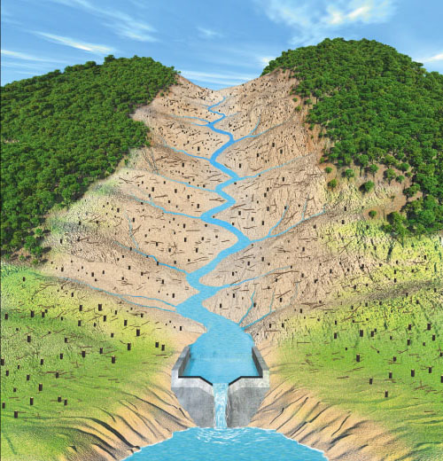
The Effects of Deforestation on the Loss of Water and Soil Nutrients
Stepped Art
Fig. 2-1, p. 31
Notes:
Figure 2-1: This controlled field experiment measured the loss of water and soil nutrients from a forest due to deforestation. The forested valley (left) was the control site; the cutover valley (right) was the experimental site.

Slide 4
2-2 What Is Matter and What Happens When It Undergoes Change?
Matter
Consists of elements and compounds, which are in turn made up of atoms, ions, or molecules
The law of conservation of matter
Whenever matter undergoes a physical or chemical change, no atoms are created or destroyed

Slide 5
Matter Consists of Elements and Compounds
Matter has mass and takes up space
Elements
Have unique properties
Cannot be broken down chemically into other substances
Compounds
Two or more different elements bonded together in fixed proportions

Slide 6
Gold and Mercury Are Chemical Elements
Fig. 2-3, p. 36
Notes:
Figure 2-3: Mercury(left) and gold(right) are chemical elements. Each has a unique set of properties and cannot be broken down into simpler substances.

Slide 7
Chemical Elements Used in The Book
Table 2-1, p. 36

Slide 8
Atoms, Molecules, and Ions Are the Building Blocks of Matter
Atomic theory
All elements are made of atoms
Subatomic particles
Nucleus of the atom
Protons have positive charge
Neutrons have negative charge
Negatively charged electrons orbit the nucleus

Slide 9
Atoms, Molecules, and Ions Are the Building Blocks of Matter (cont’d.)
Atomic number
Number of protons in nucleus
Mass number
Number of protons plus neutrons in nucleus

Slide 10
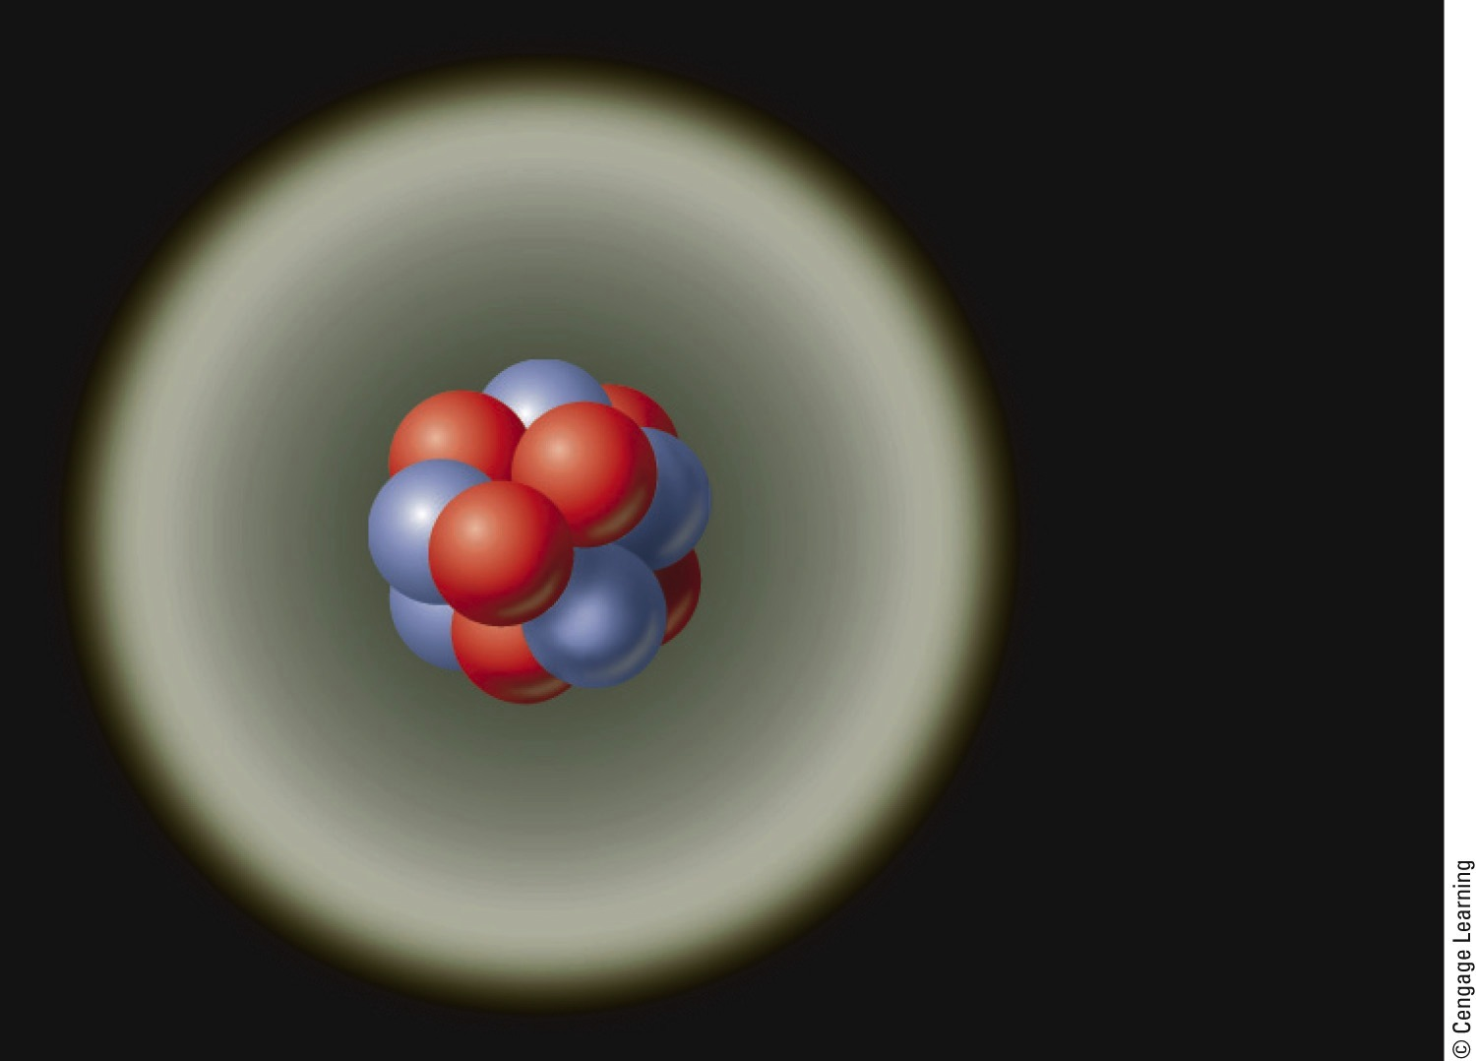
Model of a Carbon-12 Atom
6 protons
6 neutrons
6 electrons
Fig. 2-4, p. 36
Notes:
Figure 2.5: This is a greatly simplified model of a carbon-12 atom. It consists of a nucleus containing six protons, each with a positive electrical charge, and six neutrons with no electrical charge. Six negatively charged electrons are found outside its nucleus.

Slide 11
Atoms, Molecules, and Ions Are the Building Blocks of Matter (cont’d.)
Isotopes
Same element; different number of protons
Ions
Net positive or electric charge
More or less electrons
Acidity
Measured with pH

Slide 12
Chemical Ions Used in This Book
Table 2-2, p. 36
Notes:
TABLE 2-2

Slide 13
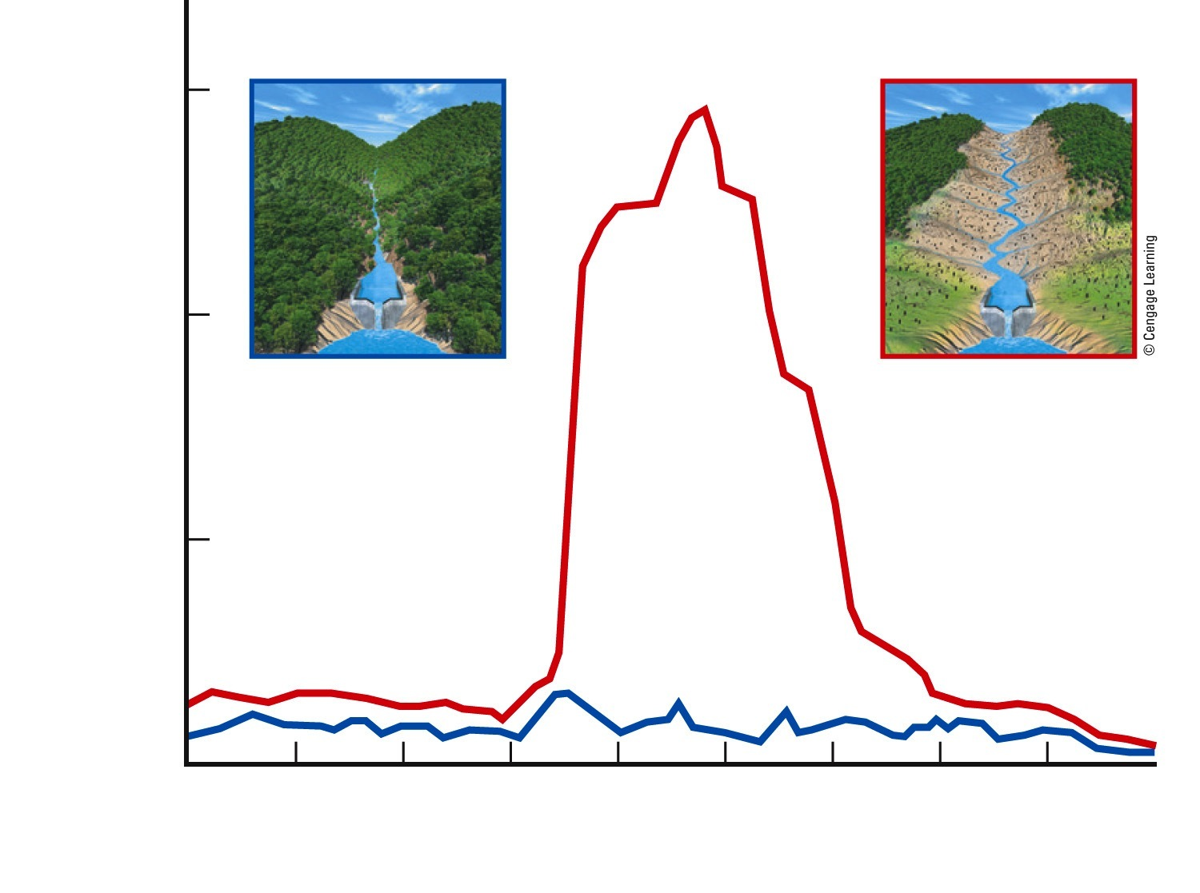
Loss of NO₃⁻ from a Deforested Watershed
60
Nitrate (NO₃–) concentration
(milligrams per liter)
40
Disturbed (experimental) watershed
Undisturbed (control) watershed
20
1963 1964 1965 1966 1967 1968 1969 1970 1971 1972
Year
Fig. 2-5, p. 37
Notes:
Figure 2.5 This graph shows the loss of nitrate ions (NO 2) from a 3 deforested watershed in the Hubbard Brook Experimental Forest (Core Case Study).

Slide 14
Compounds Used in This Book
Table 2-3, p. 38

Slide 15
Organic Compounds Are the Chemicals of Life
Organic compounds
Contain at least two carbon atoms
Types
Hydrocarbons and chlorinated hydrocarbons
Simple carbohydrates
Macromolecules: complex organic molecules
Complex carbohydrates, proteins, nucleic acids, and lipids

Slide 16
Matter Comes to Life through Cells, Genes, and Chromosomes
Cells
Fundamental units of life
All organisms have one or more cells
Genes
Sequences of nucleotides within DNA
Instructions for proteins
Create inheritable traits
Chromosomes: composed of many genes

Slide 17
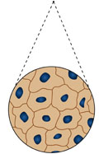
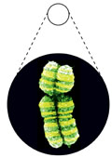
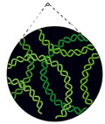
A human body contains trillions
of cells, each with an identical set
of genes.
Each human cell (except for red
blood cells) contains a nucleus.
Each cell nucleus has an identical set
of chromosomes, which are found in
pairs.
A specific pair of chromosomes
contains one chromosome from each
parent.
Each chromosome contains a long
DNA molecule in the form of a coiled
double helix.
Genes are segments of DNA on
chromosomes that contain instructions
to make proteins—the building blocks
of life.
Stepped Art
Fig. 2-7, p. 42
Notes:
Figure 2-8: This diagram shows the relationships among cells, nuclei, chromosomes, DNA, and genes.

Slide 18
Matter Undergoes Physical, Chemical, and Nuclear Changes
Physical change
No change in chemical composition
Chemical change
Change in chemical composition
Nuclear change
Radioactive decay
Nuclear fusion
Nuclear fission

Slide 19
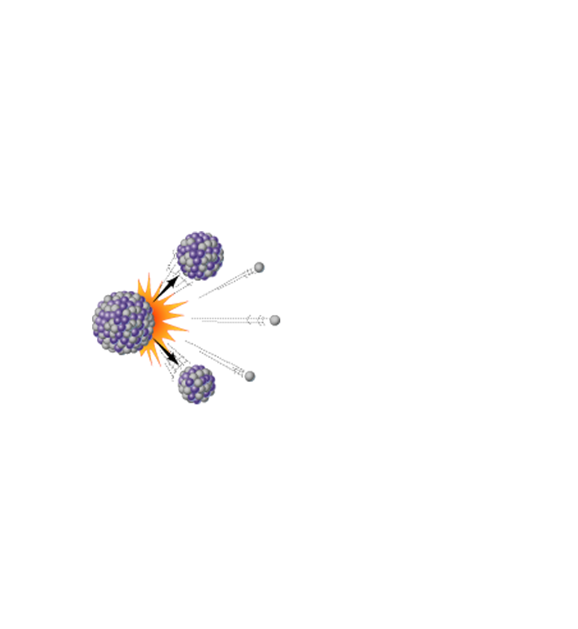
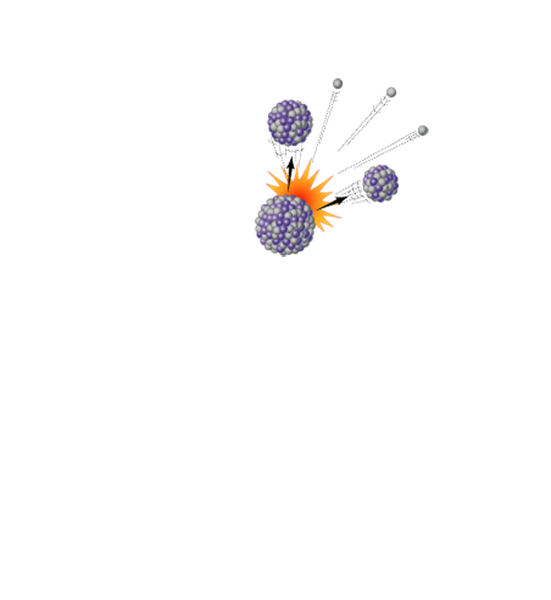
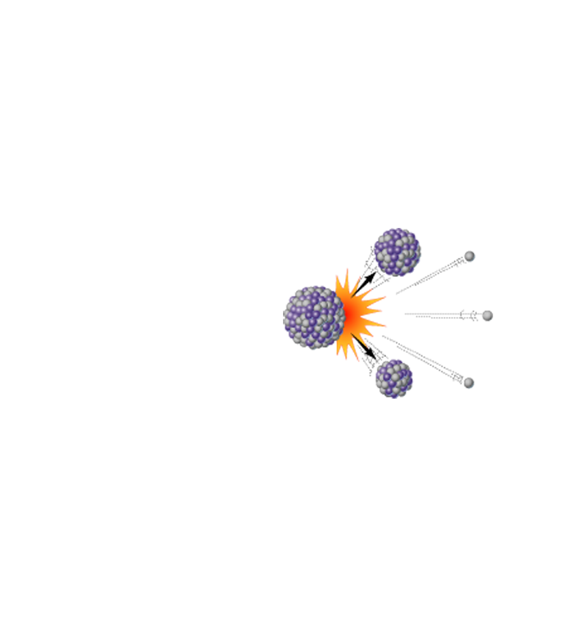
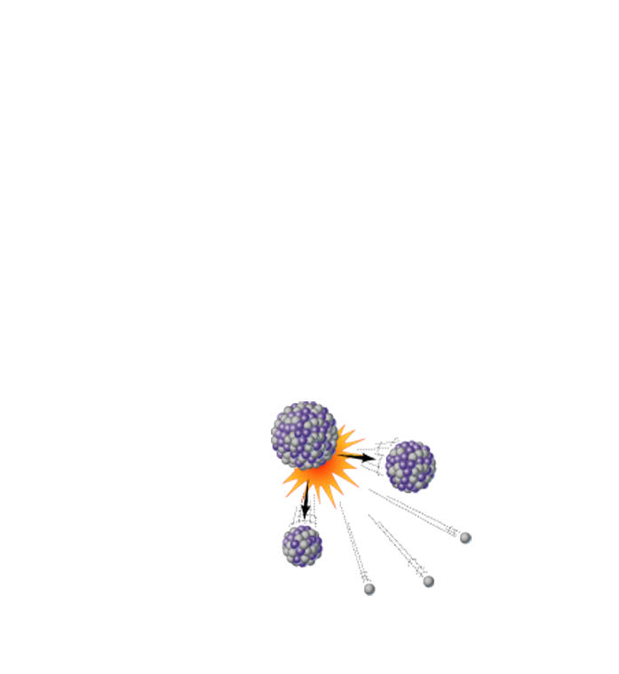
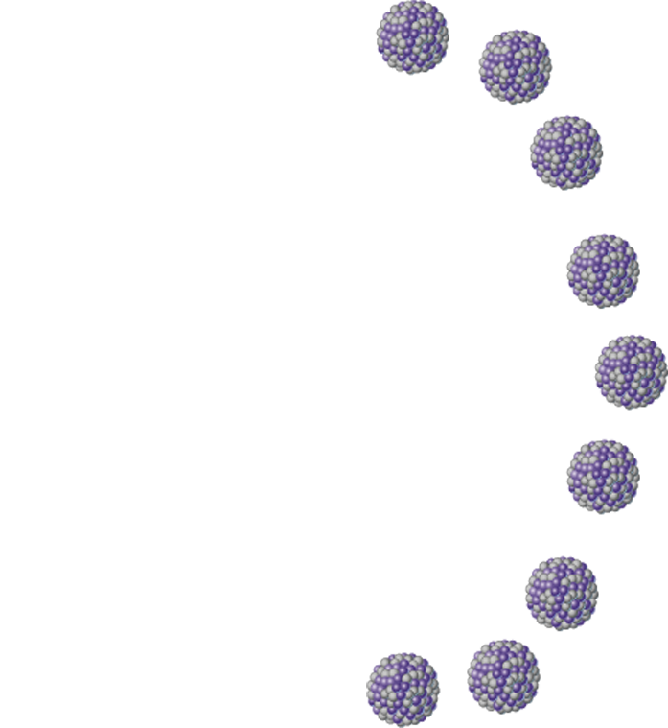
Uranium-235
Uranium-235
Uranium-235
Energy
Fission
fragment
Uranium-235
n
n
Neutron
n
n
Energy
Energy
Uranium-235
Uranium-235
n
n
Fission
fragment
Uranium-235
Energy
Uranium-235
Uranium-235
Stepped Art
Uranium-235
Fig. 2-9b, p. 43
Notes:
Figure 2-9: There are three types of nuclear changes: natural radioactive decay (top), nuclear fission (middle), and nuclear fusion (bottom).

Slide 20
We Cannot Create or Destroy Atoms: The Law of Conservation of Matter
We can change elements and compounds from one physical or chemical form to another
We cannot create or destroy atoms

Slide 21
2-3 What is Energy and What Happens When It Undergoes Change?
Whenever energy is converted from one form to another in a physical or chemical change, two changes may happen:
No energy is created or destroyed (first law of thermodynamics)
We end up with lower quality or less-usable energy than we started with (second law of thermodynamics)

Slide 22
Energy Comes in Many Forms
Kinetic energy
Energy of movement
Heat
Electromagnetic radiation
Potential energy
Stored energy
Can be changed into kinetic energy

Slide 23
Wind’s Kinetic Energy Moves This Turbine
Fig. 2-10, p. 41
Notes:
Figure 2-10: Kinetic energy, created by the gaseous molecules in a mass of moving air, turns the blades of this wind turbine. The turbine then converts this kinetic energy to electrical energy, which is another form of kinetic energy.

Slide 24
The Electromagnetic Spectrum
Visible light
Shorter wavelengths and higher energy
Gamma rays
UV radiation
Infrared radiation
TV, Radio waves
Longer wavelengths and lower energy
X rays
Microwaves
Wavelengths (not to scale)
Nanometers
Micrometers
Centimeters
Meters
Fig. 2-11, p. 41
Notes:
Figure 2-11: The electromagnetic spectrum consists of a range of electromagnetic waves, which differ in wavelength (the distance between successive peaks or troughs) and energy content.

Slide 25
Potential Energy
Fig. 2-12, p. 42
Notes:
Figure 2-12: The water stored in this reservoir behind a dam in the U.S. state of Tennessee has potential energy, which becomes kinetic energy when the water flows through channels built into the dam where it spins a turbine and produces electricity—another form of kinetic energy.

Slide 26
Renewable and Nonrenewable Energy
Renewable energy:
Gained from resources that are replenished by natural processes in a relatively short time
Nonrenewable energy:
Resources can be depleted and are not replenished by natural processes within human timescales

Slide 27
Fossil Fuels
Fig. 2-13, p. 43
Notes:
Figure 2-13: Fossil fuels: Nonrenewable oil, coal, and natural gas (left, center, and right, respectively) supply most of the commercial energy that we use to supplement renewable energy from the sun.

Slide 28
Some Types of Energy Are More Useful Than Others
High-quality energy
High capacity to do work
Concentrated
Examples:
High-temperature heat, strong winds, and fossil fuels
Low-quality energy
Low capacity to do work
Dispersed

Slide 29
Energy Changes Are Governed by Two Scientific Laws
First Law of Thermodynamics (revisited)
Law of conservation of energy
Energy is neither created nor destroyed in physical and chemical changes
Second Law of Thermodynamics (revisited)
Energy always goes from a more useful to a less useful form when it changes from one form to another

Slide 30
2-5 What Are Systems and How Do They Respond to Change?
Systems have inputs, flows, and outputs of matter and energy, and feedback can affect their behavior

Slide 31
Systems Respond to Change through Feedback Loops
System
Set of components that interact in a regular way
Examples:
Human body, the earth, and the economy
Feedback
Any process that increases or decreases a change in a system

Slide 32
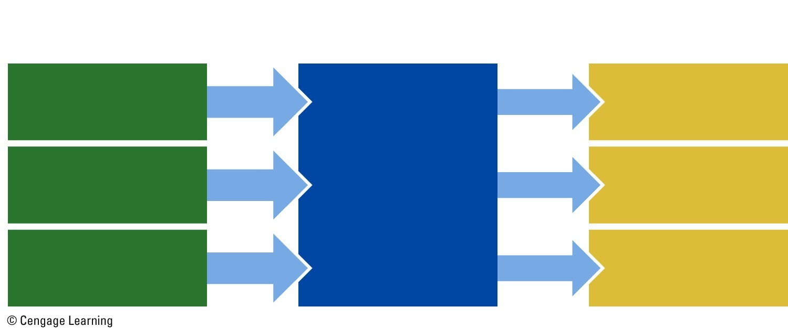
Inputs, Throughput, and Outputs of an Economic System
Inputs
(from environment)
Outputs
(to environment)
Throughputs
Energy resources
Work or products
Matter resources
System processes
Waste and pollution
Information
Heat
Fig. 2-15, p. 44
Notes:
Figure 2-15: A greatly simplified model of a system.

Slide 33
Systems Respond to Change through Feedback Loops (cont’d.)
Positive feedback loop
Causes system to change further in the same direction
Can cause major environmental problems
Negative, or corrective, feedback loop
Causes system to change in opposite direction

Slide 34
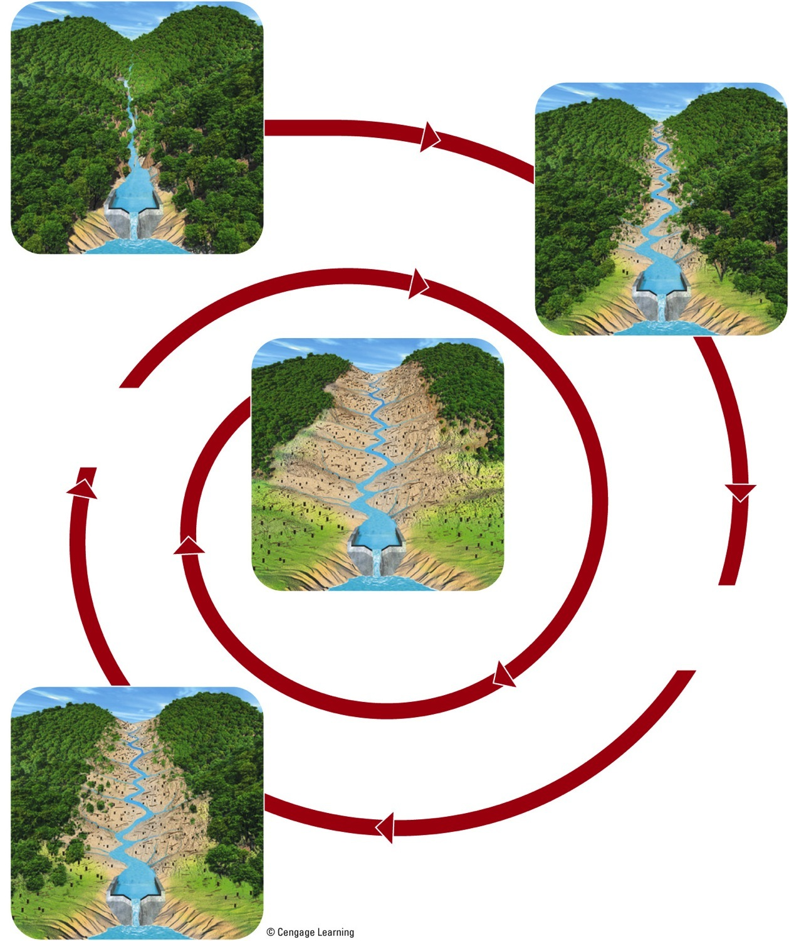
Positive Feedback Loop
Decreasing vegetation...
... which causes more vegetation to die.
... leads to erosion and nutrient loss...
Fig. 2-16, p. 45
Notes:
Figure 2.16 A positive feedback loop. Decreasing vegetation in a valley causes increasing erosion and nutrient losses that in turn cause more vegetation to die, resulting in more erosion and nutrient losses. Question: Can you think of another positive feedback loop in nature?

Slide 35
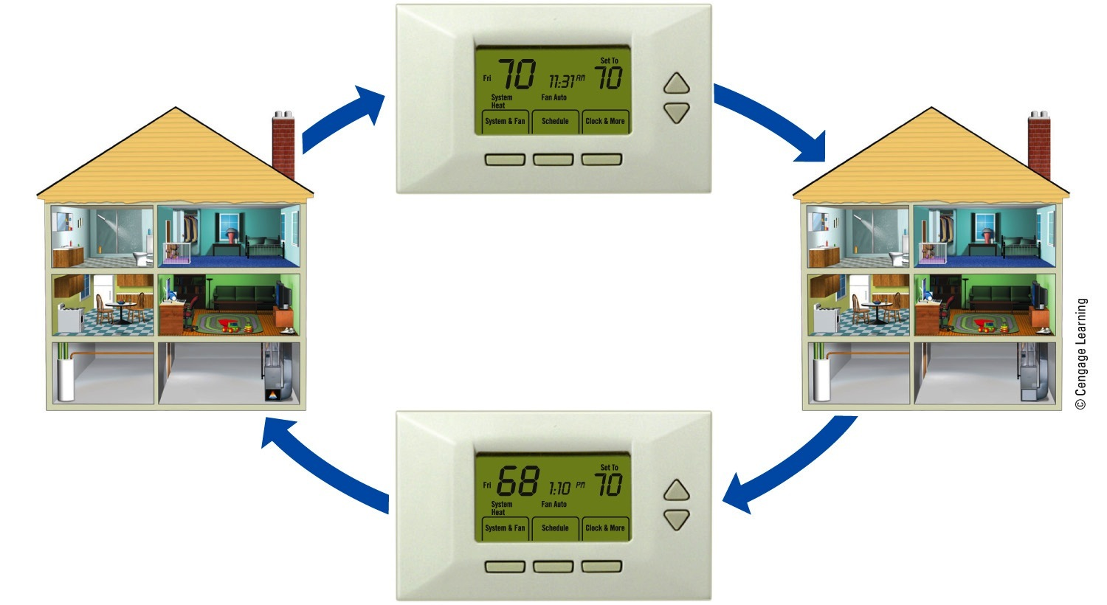
Negative Feedback Loop
House warms
Temperature reaches desired setting and furnace goes off
Furnace on
Furnace off
House cools
Temperature drops below desired setting and furnace goes on
Fig. 2-17, p. 46
Notes:
Figure 2-17: A negative feedback loop. When a house being heated by a furnace gets to a certain temperature, its thermostat is set to turn off the furnace, and the house begins to cool instead of continuing to get warmer. When the house temperature drops below the set point, this information is fed back to turn the furnace on until the desired temperature is reached again.

Slide 36
It Can Take a Long Time for a System to Respond to Feedback
Time delay
Amount of time between the input of a feedback stimulus and the response to it
Tipping point, threshold level
Fundamental shift in the behavior of the system

Slide 37
System Effects Can Be Amplified through Synergy
Synergistic interaction and synergy
Two or more processes combine in such a way that combined effect is greater than the two separate effects
When is a synergistic interaction helpful? When might it be harmful?

Slide 38
Three Big Ideas
You cannot really throw anything away
According to the law of conservation of matter, no atoms are created or destroyed whenever matter undergoes a physical or chemical change
Thus, we cannot do away with matter; we can only change it from one physical state or chemical form to another

Slide 39
Three Big Ideas (cont’d.)
You cannot get something for nothing
According to the first law of thermodynamics, or the law of conservation of energy, whenever energy is converted from one form to another in a physical or chemical change, no energy is created or destroyed
This means that in causing such changes, we cannot get more energy out than we put in

Slide 40
Three Big Ideas (cont’d.)
You cannot break even
According to the second law of thermodynamics, whenever energy is converted from one form to another in a physical or chemical change, we always end up with lower-quality or less usable energy than we started with

Slide 41
Tying It All Together
The Hubbard Brook Forest Experiment and Sustainability
Revealed that clearing a mature forest degrades natural capital
How far can we go expanding our ecological footprints without threatening our own quality of life?
We need to maintain balance

